Slide 1


Developing an effective research design
Professor Yvonne Brunetto (SCU)

Slide 2

If you don’t know where you are going, any path will do ….

Slide 3
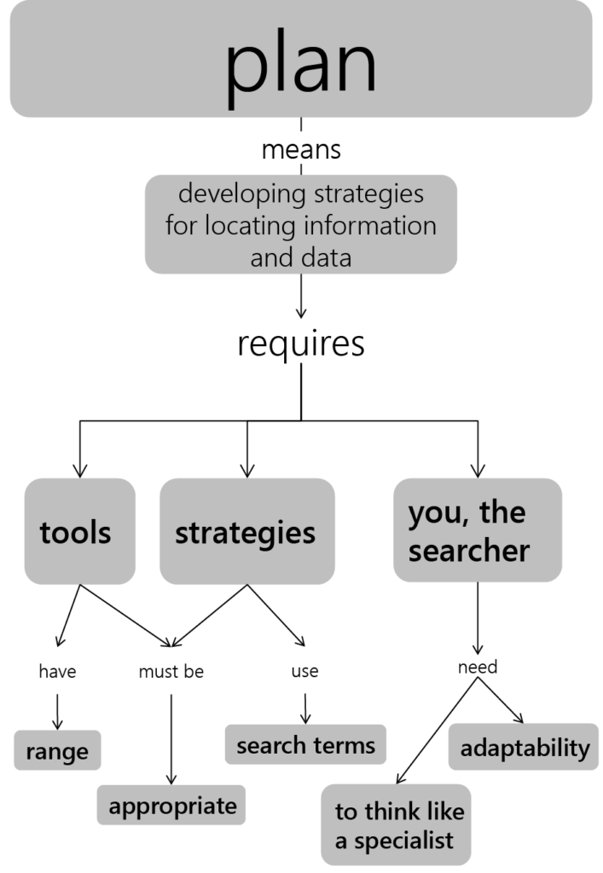
What is research design?
Research design is a blueprint (a plan) guiding how a specific research question is answered.
It guides how the research problem is interpreted, and the theoretical and methodological lenses used to collect, analyse and interpret data to address the research problem.
This Photo by Unknown Author is licensed under CC BY-SA-NC

Slide 4
The process begins with reflection to answer the following questions:
What is the research problem?
Does this thesis sit within management or psychology or public administration?
The answers will shape how you frame your theoretical framework, which will then inform the methodological framework.
This workshop will examine how to answer these questions using standard research protocols.

Slide 5
Similarities and differences across theses based on Psychology, Management (HR, Supply Chain etc) and Public Administration
Thesis Components | Psychology discipline | Management disciplines | Public Administration
Theoretical framework | mentioned | Only the good ones | Strong theoretical component
Conceptual framework | 1 chapter | 1 chapter | 1 chapter
Methods | Multi-study with different aims, backgrounds, methods, results and discussion | One study only – either quantitative or qualitative or pragmatic | Usually qualitative (document analysis), or if the theme is policy implementation, then there might be a qualitative and quantitative component
Context | Not as important | Mainly in the Method section | Very important – can be a separate chapter
FOCUS is on: | A good thesis demonstrates the highest level of methodological proficiency. Theory and concept development are still important, but do not dominate the | A good thesis has a theoretical chapter, followed by a conceptual chapter, followed by a methodology chapter usually using one or two (mixed) methods | A good thesis has a very strong theoretical public administration framework underpinning the argument, followed by conceptual framework and methodology

Slide 6
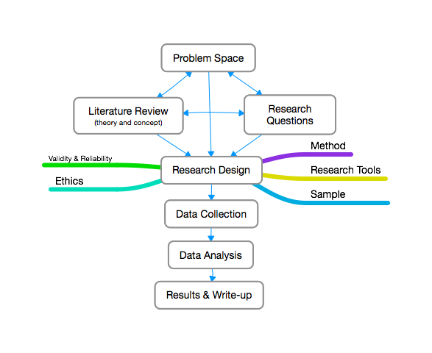

Slide 7
Steps to construct a literature review
Search journal databases, books, reports to find similar/related studies (white and grey literature)
Assess quality and relevancy of collected sources (journal articles, books, etc)
Summarise key findings related to potential causes of the problem
Construct analytical ‘mind map’ or conceptual framework that orders and links the themes and information in a logical order
Notes:
Constructing a literature review involves the following steps: and this is in your study guide
Search journal databases, books, reports to find similar/related studies.
2. Assess the quality and relevancy of collected journal articles, books and reports to ensure studies are consistent with evidence-based research approaches.
3. Summarise key findings from collected, quality journal articles, books and reports around a set of pertinent themes.
4. Construct an analytical ‘mind map’ or conceptual framework that orders and links the themes and information in a logical order.
5. Construct a set of paragraphs that lists key findings from previous literature, ensuring that related findings are linked.
I really want to focus on the two first steps. This is because this is where most people stumble, this is where most people have serious issues and this leads to problems later on. The biggest issues we see is with regard to assessing the quality of the sources.

Slide 8
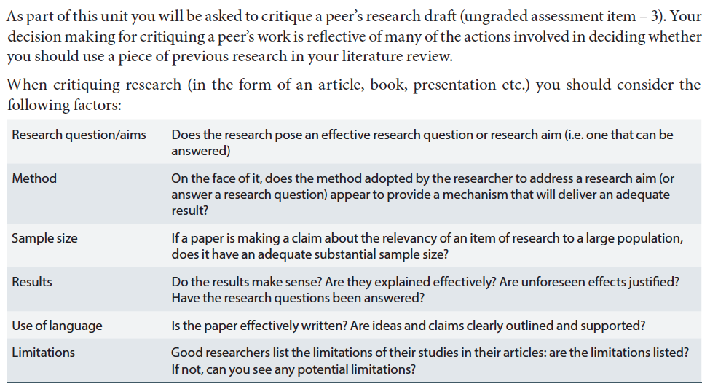
Critiquing research
Notes:
Of course you should always be critical of what you read. Here are some questions that could lead your critical thinking

Slide 9

After reviewing the literature, a researcher must find the gap
HOW?
Identify the research problem by
Review previously published literature about it,
Break up the problem into sub problems – which you can express as secondary research questions or hypotheses
Identify the data required to address (answer) the gap
Examine which methods of collecting and analysing the data addresses the gap.

Slide 10
Two important considerations when deciding on a research design
Nature of research question
Comprehensiveness of literature
Notes:
Ethical clearance for our unit
This is a legal obligation in the first place
It is our responsibility as researchers to make sure NOONE is put at risk because of our research.
Example: do research into intention to turnover, report names back who are likely to leave, might get sacked
Or: student who wanted to ask about corrupt behaviour in the workplace.
There are other touchy issues where collecting data can be a very difficult and potentially unethical thing. Imagine doing research into mental health issues in the world place! Or bullying!
There is a number of issues:
Respondents must remain anonymous so they are not put at risk – e.g. because they report on corrupt behaviour
You are not likely to get valid responses, because it is such a touchy subject - BUT it is also a way to ensure that you get good data
Main Issues
Disclose in advance that you are doing research
People MUST participate volunarily, not because you make them because e.g. you are their manager
ANONYMITY, never disclose names. In small organisational contexts make sure you don’t mention too many details (e.g. 50 year old manager)
NON-THREATENING, NON-PERSONAL, NON-INTRUSIVE

Slide 11
What is a research paradigm?
It refers to how you interpret the world (your basic assumptions for explaining how the world works … researcher’s understanding of ‘reality’. Is there one objective reality (such as the sun rises each morning) or multiple, socially constructed realities (such as working from home increases productivity)
Interpretivism,
2. Pragmatism,
3. Positivism
4. Post-positivism

Slide 12
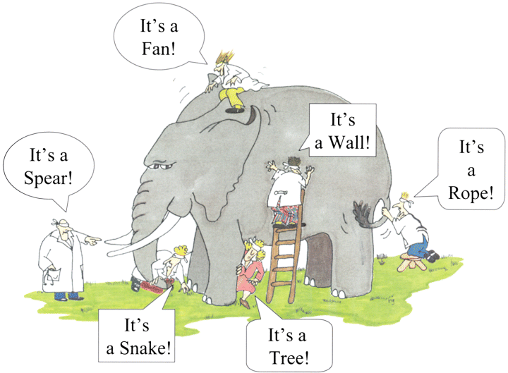
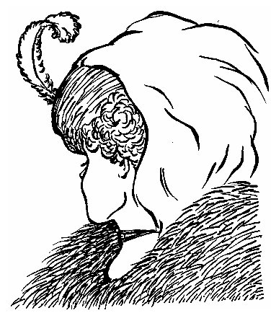
Perspective vary across individuals and their experiences
Picture sources:
https://sandiebakowski.files.wordpress.com/2012/02/perspectives.jpg
http://shafiq-asimplelife.blogspot.com.au/2012/06/different-perspectives.html
Notes:
These two pictures are just supposed to illustrate what I just said – that it is all a matter of perspective! – particularly in the elephant picture.
Who knows the picture on the left hand side?

Slide 13
Assumptions of interpretivism, positivism, post-positivism and pragmatism
Description (Creswell, 2009) | Interpretivism | Positivism | Post-Positivism | Pragmatism
Ontology | It is socially constructed, and so there are many realities. | Nature sciences, one objective reality | Critical realism – closer to reality. | Some attempt to match explanation of reality within specific parameters
Epistemology | Assumes knowledge is interpreted based on values and experiences | Data is independent of the researcher. | Somewhat objective. | A mix of subjective and objective views in a study.
Axiology | Attempts to make sense of the why and how people’s actions. | Research is value free. | Attempts to reduce impact of values | Values inform interpretation of findings.
Methodology | Inductive mostly qualitative. | Deductive. | Modified deductive process | Abduction both inductive and deductive;

Slide 14

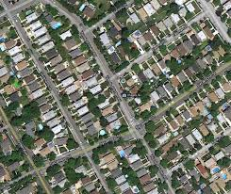
Qualitative vs Quantitative
Research Methods
→ Most importantly: Research approach needs to fit the research aim!
Notes:
Just to do a very quick distinction:
Qualitative research seeks to understand and find meaning in words and text. It constructs meaning. It is interested in drilling down really deep, focussing on only a few respondents, but painting a very holisitic picutre.
Quantitative research in contrast looks at patterns and computes these patterns in numbers. It is about measuring things, it is about finding patterns across a large number of respondents and ideally being able to come up with conclusions or explanations that can be generalised for the majority of cases.
Up until about 30 years ago, in the business field, there was only quantitative research.
Qualitative data in business research was unheard of – it only emerged in the past 30 years
Mixed methods has emerged to capture the best of both worlds
Ben is really strong and has a preference for quantitative and mixed methods research, I sway towards qualitative research, but again, not because one is better than the other, but in the context of my own research, it generally just generates the better data.
This is great for you, because there is a lot of expertise in your teaching team and we are always happy to help wherever we can

Slide 15
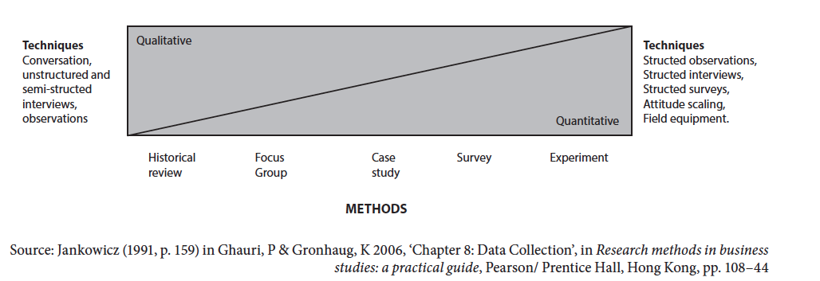
Research tools
Activities/techniques/instruments used to solicit data from a sample
Before you decide on a research tool, you need to make a few important decisions
  What approach is best suited to the context of my research (method type)?
  How can I realistically get the required data?
Notes:
Just and overview to the last two slides
This is in the study guide, and we already talked about a few of the tools before
We will talk about the tools in the coming 3 weeks in more detail
Experiment comes from science – 2 groups of people, one group has an intervention, the other is the control group
Survey
Case study – if you are interested, read Yin. Basically you can do a case study using both qual and quant data. It is a research approach in itself
Focus group – interviews with a number of people, comes from marketing research
Historical review – mostly using secondary data

Slide 16
Data needs for Quantitative study
Demographic data
Data to measure psychological factors/ competencies / profit margins / resources – by use of surveys
Dependent, Independent, Mediating and Moderating Variables
  Statistical analysis
    Correlation (which factors are related to each other)
    Multiple Regression (impact of each independent variable on the dependent variable)
    Structural Equation Modeling (SEM)
    Mean Score comparison
Notes:
It uses surveys, also to measure psychological factors
Now what does that mean? It means that we are trying to capture concepts like Workplace commitment – the relationship you have with your manager – your entrepreneurial orientation –
You might develop a survey, you might use a survey someone else developed
You can also ask for demographic factors (gender, age, etc)
In quant analysis we look at different variables. The focus is always on the dependent variable. If we look at the effect of X on Y, the dependent variable is Y. The independent is X – it’s the thing that changes, it’s the thing that impacts on the dependent one.
Mediating, moderating, we don’t have to worry about that too much – third factors that strenghten or change the relationship between the dependent and independent variable
Don’t worry about complex math, we will do a quick run of it. The one you are most likely to use is mean score analysis – graphs where averages are displayed.

Slide 17
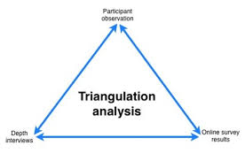
Pragmatic research methods relies on triangulation
Typically a mixed method research project will employ at least 2 different data collection techniques (research tools).
This is done so that outcomes/findings can be compared across different data collection techniques – this helps in establishing the validity of your research findings
Notes:
Triangulation – make sure that we arrive at valid results
Basically, we look at the same problem from two different angles. This is to make sure that you kind of see the same thing if you look from different angles because then you know you arrive at correct and valid conclusions.
For instance, you could do interviews and then triangulate them with an analysis of relevant documents that deal with the same issues

Slide 18
Different research designs: How do you choose which one to adopt?
Research design | Description | Advantages | Disadvantages
Action research | Problem identified, intervention, measure outcomes, See Appreciative Inquiry | Collaborative, adaptive, solution-focused | Hard to conduct conventional research whilst promoting change. Hard to write up and publish
Case studies | In-depth study within narrow parameters using multiple methods | Provides avenue for examining a complex issue, especially when there isn’t much research | Aberration – how typical is it of reality
Cross sectional | Provides a snapshot of outcome for a particular cohort at a specific point in time. | Use surveys to gather data, which is relatively inexpensive. Industry welcomes it because it is less time intensive | Despite the use of sophisticated statistical analysis, some researchers argue causal links can not be proven, although theory should determine this anyway.
Experimental | By giving an intervention for one group and a placebo to the control, the findings demonstrate significant relationships | Is useful in demonstrating a causal relationship | The design is artificial, and not realistic to the real world, which may affect participant’s behaviour. It also can be expensive to run.

Slide 19
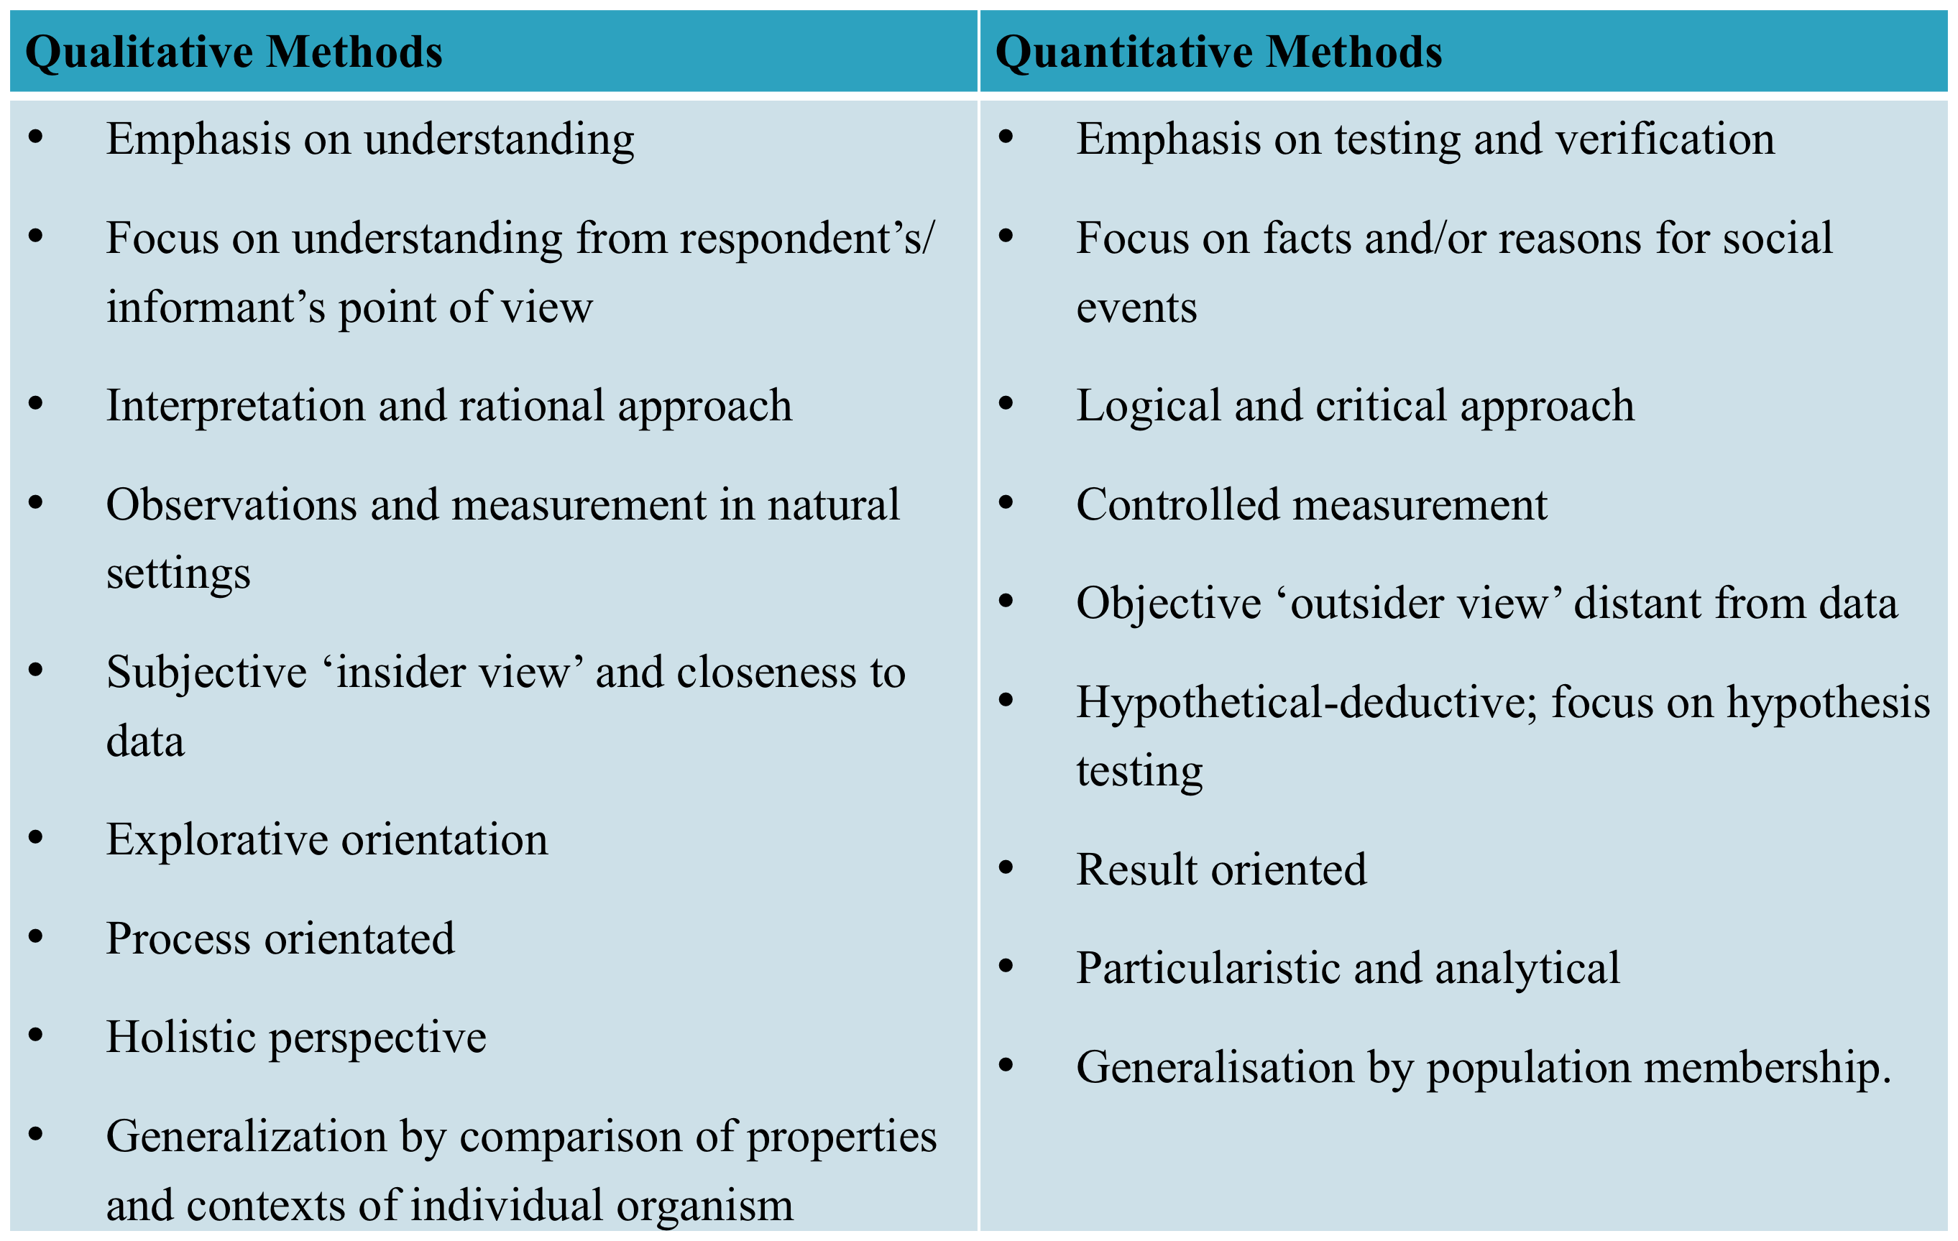

Slide 20

What does Action Research look like?
This Photo by Unknown Author is licensed under CC BY-NC-ND

Slide 21
Action research example: Brunetto, Y., Dick, T., Xerri, M., Cully, A (2020) Building capacity in the healthcare sector: A strengths based approach for increasing employees’ well-being and organisational resilience Journal of Management & Organisation 26 (3) 309-323
Abstract
Appreciative Inquiry (AI) as a lens for informing the process for building on employees’ existing wellbeing within one Australian organisation, using the ‘discovery, dreaming, designing, and achieving destiny’ process. Using POSH as a theoretical framework, we worked with a large NFP healthcare organisation as part of the ‘discovery’ phase to identify elements of what was positive, flourishing, and life-giving in the practices of their employees.
During the ‘dreaming’ process, employees’ wellbeing was identified as a strength.
During the ‘designing’ phase, a training program was co-designed to build on employees’ existing levels of wellbeing.
This paper reports outcomes as part of the ‘achieving destiny component’ of the AI process. In particular, the outcomes show that employees’ knowledge of, and ability to use positive emotions increased, which is a positive first step for increasing employees’ wellbeing and organisational resilience.
The dreaming stage took about 4 months for employees to identify what they needed.
The designing stage was collaborative
The delivery of the intervention occurred over 18 months
Each intervention involved pre and post testing
N=98 is reported (n=56 is not reported)
It involved nurses, physiotherapists, Drug & Alcohol councillors, personal carers, occupational therapists
Five different units within one large NFP
Intervention approximately 15 hours, over two time periods, separated by at least 2 weeks
Outcomes different from theory. Identified the importance of understanding the PsyCap and emotional awareness of cohort before beginning training.

Slide 22
What does a multi-level study look like?

Slide 23
How do you undertake a cross sectional design across multiple countries?

Slide 24

Cross sectional design across counties? Brunetto Y., Xerri, M., Trinchero, E., Beattie, R., Shacklock, K., Farr-Wharton, R & Borgonovi, E (2018) Comparing the impact of management on public and private sector nurses in UK, Italy and Australia Public Management Review 20 (4) 525-544
The research examined the impact of management upon employee outcomes (perceptions of discretionary power, well-being, engagement, and affective commitment), comparing public and private sector nurses in Australia, the United Kingdom, and Italy.
Overall, 1,945 nurses participated in a self-report survey within these core and laggard-New Public Management countries.
While management influenced employee outcomes for each country, there were significant differences between the public and private sectors, with private sector nurses reporting higher perceptions of outcomes.
Importantly, nurses’ engagement was affected by management practice for each country. This study raises important implications for nurse managers, especially public sector managers, described within.

Slide 25
Engagement R2
AUS = .77; ITA = .82
UK = .70
Private = .75 Public = .71
POS
Aus. = .32***
Italy = .19**
UK = .23***
Private= .33***
Public= .20***
Aus. = .23***
Italy = .27***
UK = .26***
Private= .22***
Public= .22***
Aus. = .69***
Italy = .67***
UK = .77***
Private= .68***
Public= .69***
Aus. = .19***
Italy = .21***
UK = .42***
Private=.22***
Public= 27***
Discretionary
Power R2
AUS = .13, ITA = .19
UK = .17
Private = .15, Public = .18
Affective
commitment R2 -
AUS = .77, ITA = .82
UK = .70
Private = .75 Public = .71
Aus. = -.04
Italy = .09***
UK = .10
Private= -.039
Public=.11***
Aus. = .31**
Italy = .01
UK = .15
Private= .12
Public= .22***
Aus. = .51***
Italy = .37***
UK = .38***
Private= .45***
Public= .41***
Well-being R2
AUS = .40
ITA = .27
UK = .30
Private = .36
Public = .31
Aus. = .24*, Italy = .65***
UK = .51***
Private= .43***; Public= .45***
LMX

Slide 26
Multi-level study: Farr-Wharton, B., Xerri, M & Brunetto, Y (2021) Austerity, Staff Inadequacy, and Contracting-Out Social Services: How many Government Inquiries does it take to improve social policy outcomes in aged care? Australian Journal of Public Administration https://onlinelibrary.wiley.com/doi/epdf/10.1111/1467-8500.12463
Abstract:
This study examines policy implementation as it unfolds from policy, to the contractors and then to its impact on employees delivering the social service.
Multilevel statistical analysis is used to examine survey data from 36 contractors and 542 employees. The use of multilevel analysis provides a methodological tool and subsequent analysis new to the discipline of public administration.
The results indicate a strong positive association between resource (in)adequacy decision-making at the contractor level and employee outcomes.
The contribution of the paper is new evidence to support the widening of existing quality care indicators to include organisational support metrics for contractors.
Process
CEOs and/or Human Resource Managers of these residential aged care organisations were invited to participate by mail/email, and this was followed up with a phone call invitation. In all, three organisations signed up in Sydney (with a total of 16 separate facilities between them), 11 in Brisbane (each with one facility), and one in Perth (with nine facilities) – making a total of 36 residential aged care facilities where data collection took place.
Survey data were collected in person via site visits. Where possible, researchers visited each site over a 2-day period from morning to evening shift change, and SLBs in each facility were invited to complete the survey in their lunch/break time or prior to starting their shift.
Took 2 years to develop, collect and analyse data

Slide 28
Summary
Research design should fit the research question
It achieving impact is important to you, you have to sacrifice “publish ability’ to some extent to deliver benefits to the organisation

