Slide 1
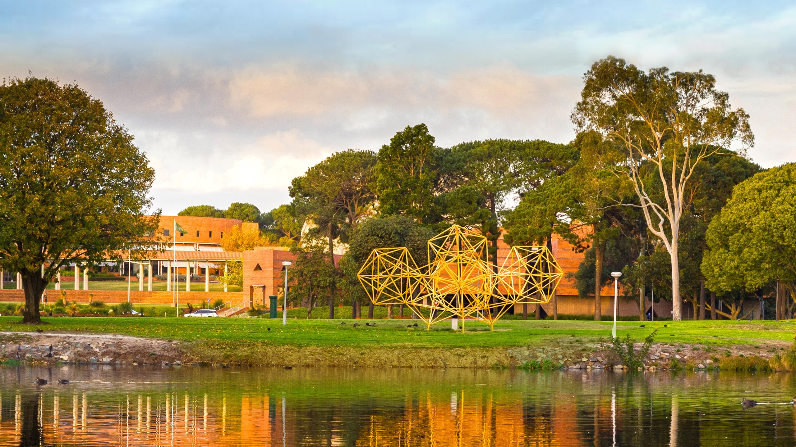

Setting Yourself Up for Success In Academia
Sharon K. Parker
ARC Laureate Fellow and John Curtin Distinguished Professor
30 November 2021
A global university Western Australia | Dubai | Malaysia | Mauritius | Singapore

Slide 2
My PhD experience
I did a PhD (a long time ago!)
Supervised/ co-supervised PhD students in the UK and Australia
Examined PhD students in different countries
Published with and/or mentored PhD students supervised by others
Reviewed many grant applications; chair of a university Academic Promotions Committee; editorial work; many selection committees; OB Division Mentor Award, 2016; run OB Doctoral Consortium; and so on

Slide 3


Part 1 - Getting your PhD:
Going the DISTANCE
Part 2 – Building
foundations for the future

Slide 4
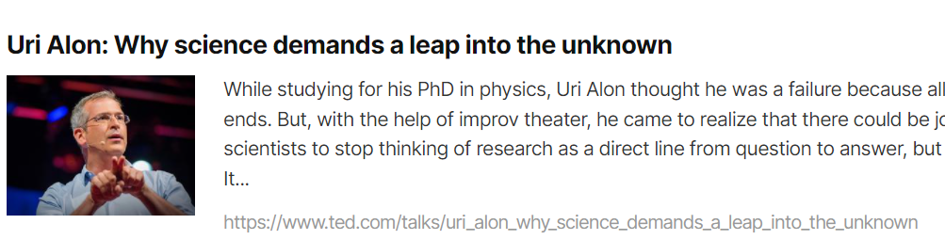
Going the DISTANCE
Direction (“I don’t know where my research is going”)
  Its ok to be ‘in the cloud’ (see Ted talk)
  Look at the “future directions” section of papers
  Do a seminar and get feedback
  Conduct a literature review (and publish
  it if you can)
  Sometimes you just have to start somewhere!
Isolation (“I feel alone”)
  Reach out – locally, nationally & internationally; find your tribe
  Exploit opportunities eg visitors, consortiums, workshops, training

Slide 5
Going the Distance (continued)
Supervision
  Not enough direction/ too much direction
    Are you expecting too much? Owning your PhD…
    Discuss how you are working together with your supervisor
  Manage (respectively) your supervisor
    Respect your supervisor’s time – always go to meetings with an agenda, don’t send things an hour before and expect them to be read, recognise your supervisor (mostly) doesn’t have to supervise you, be conscientious (don’t have your supervisor correcting your spelling)
    Learn to love feedback
Time
  Routines/ time management are essential
  Get writing now
  Build skills during your PhD

Slide 6
Everybody is busy (UC Doctoral Students)
Source: Mason, Mary Ann and Marc Goulden. 2006. “UC Doctoral Student Career Life Survey.” (http://ucfamilyedge.berkeley.edu/grad%20life%20survey.html).

Slide 7
Going the DISTANCE (continued)
ANxiety
  About many things - being an imposter,
  getting a job, getting published
  Engage in problem-focused coping
    Publishing eg literature review
    Engage in other activities eg teaching skills, networks
  Seek support
    From peers, University counsellors, your supervisors, others
    Understand you are not alone
Comparison
  Information not judgement

Slide 8
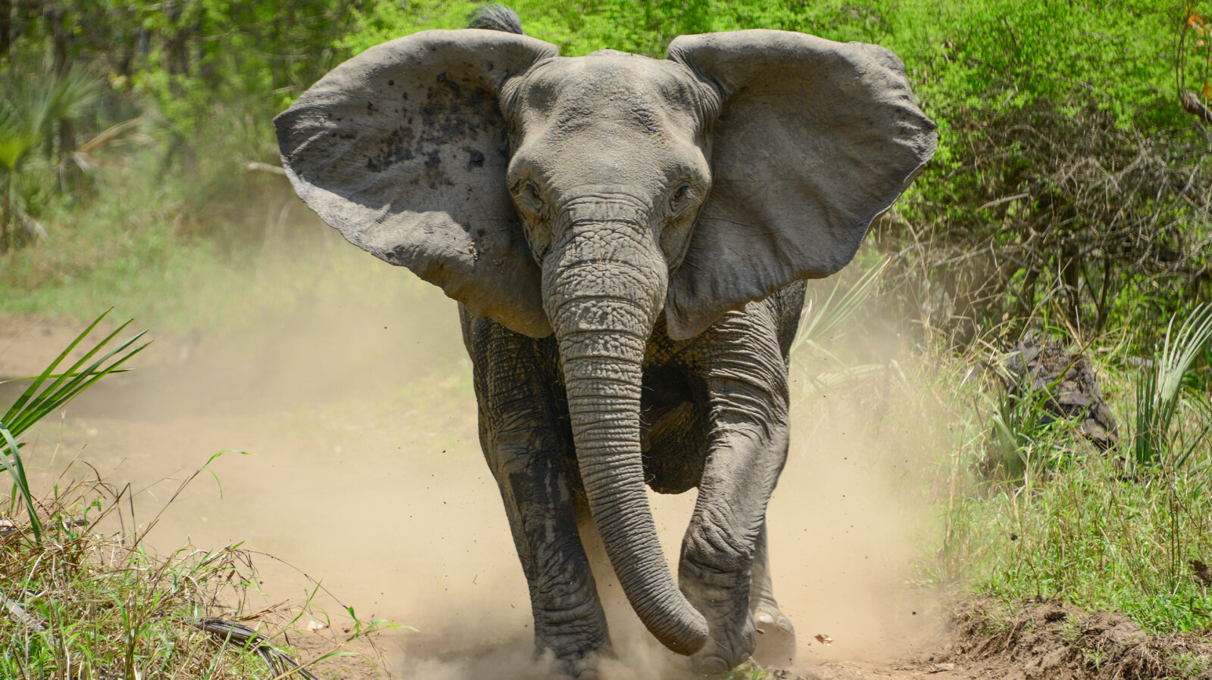
Going the DISTANCE (continued)
Elephantine “massive and scary”
  Break it down
  Set small, specific goals

Slide 9
Laying foundations for future success
CAREER SUCCESS: “real or perceived achievements individuals have accumulated as a result of their work experiences” (Judge et al., 1995)
Extrinsic | Intrinsic – subjective reactions, e.g., career satisfaction
Pay | Interest & challenge
Promotions | Meaning
Status (high status, prestigious jobs) | Choice

Slide 10
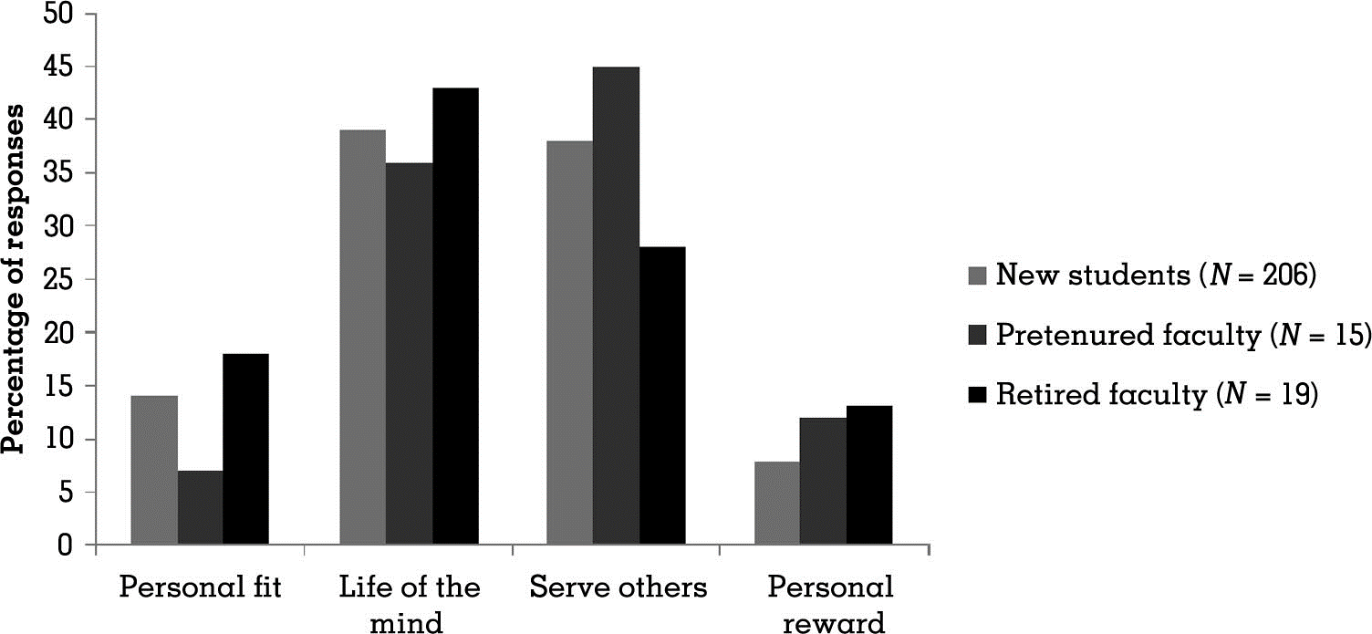
Why people choose an academic career? (Walsh, 2011)

Slide 11

How to have a successful career:
one solution
“Publish a lot of top tier articles
(and don’t do anything else)”

Slide 12
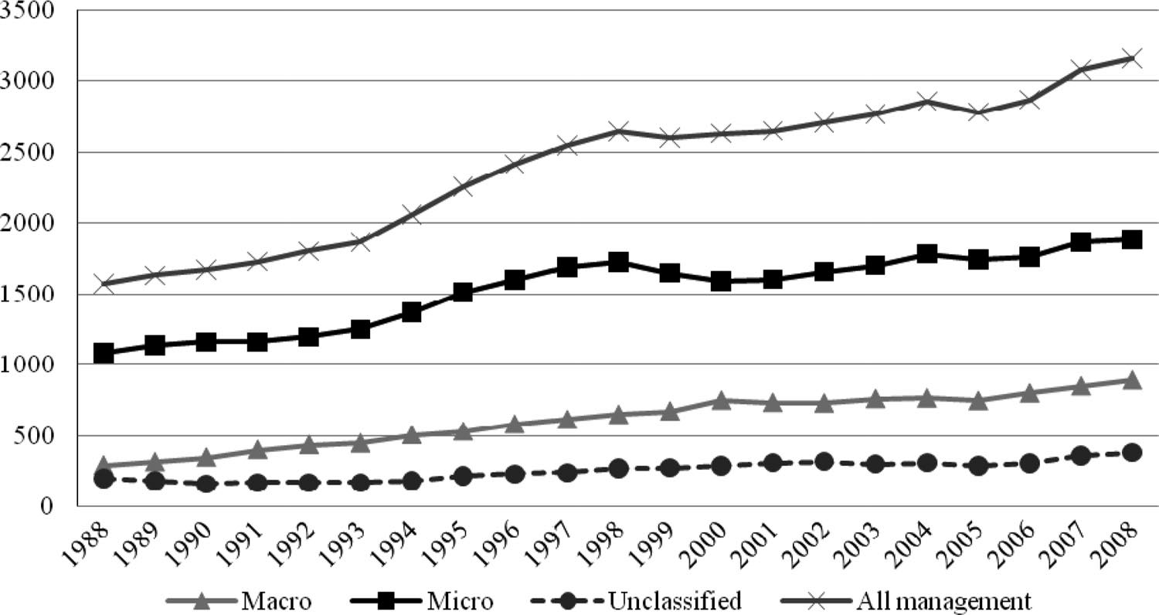
But… it’s hard to do this and getting harder!
“dramatic increase in competition” (Certo et al., 2010)
Number of authors publishing top tier articles in previous 5 years

Slide 13
“The page space in management’s top tier journals is being distributed amongst a far wider set of colleagues than ever before.”
 | 1988-1992 | 2004-2008
Average time to produce 5 top tiers | 5.24-6.93 | 8.04-9.72
Average time to produce 10 top tiers | 6.00 – 8.78 | 12.76-15.73
    Podsakoff et al. 9% of uni’s account for 85% citations and 75% pubs
There are institutional advantages
It might be even tougher for ‘non-US’……. “strong under-representation, perhaps a bias, does exist” (Baruch, 2001).

Slide 14


At the same time…
The ‘standards are higher’: methodological/ theoretical sophistication and novelty
And….
There is much more pressure to “publish many tier one articles”

Slide 15

Miller et al., (2011)
  N=104 research-oriented management departments in US AACSB-accredited business schools (N approx. 400 faculty)
  94% reported pressure to publish in peer reviewed journals (and not do other things)

Slide 16
How to respond to this situation?
Work harder and worry more?
  Significant feelings of stress/ publication burnout as a result, esp. for non-tenured and females (Miller et al., 2001); working hours increasing (Winefield et al., 2002)
  AOM PDW workshops feature successful faculty showing extremely high work loads
Quit?
  Lots of evidence of stress and burnout eg Winefield et al., (2001) 50% Australian academics risk of psychological illness
Despair?
  Walsh (2011) analysed speeches of AOM Presidents
Ignore everything except publishing (eg teaching, impact, life)
  Many argue this is happening (e.g., Miller et al., 2001; many critiques of business schools)

Slide 17
How to respond to this situation? (Continued)
Do more “safe but boring” work?
  Miller et al., (2011) 45% agreed that “pressure deters me from doing more creative research”/ using non-traditional approaches (esp. women and non-tenured)
Cheat?
  More fabrication, falsification, plagiarism (Bedian et al., 2010 “Win at all costs”)
    e.g., 79% of 384 sampled report ‘with-holding methodological details or results’ and 27% report ‘fabricated results!
Change the promotion/ tenure system?
  Many are trying! See Walsh (2011) “Courage to lead”; see also Miller et al., 2011
    Criteria – assess body of work across multiple sources (not top tier count)
    Longer time frames for evaluating senior colleagues

Slide 18

What else?

Slide 19
Be strategic in your approach
(& enjoy the means, not just the ends)

Slide 20
Career Success
Human Capital
Social Capital
Financial Capital
Psychological Capital

Slide 21
Financial capital: What you have
What | How
Funding | Research assistant work generates funds and can build your skills Start small (travel/ internal grants)

Slide 22
Human Capital: What you “know”
What | How
Ensure you are fully socialized into the profession Take every opportunity to learn the craft | Go to doctoral consortiums Exploit virtual media eg CARMA Attend all seminars Do courses Read journals Read books full of tips; learn from others; ask questions Learn by doing e.g. work with productive people inside/ outside the department Create your own opportunities Find novel ways to learn (MOOCs, CARMA); break some ‘rules’; find unique paths
eg Frost & Taylor, 1996 Rhythms of Academic Life

Slide 23
Social Capital: “Who” you know
What | How
Proactively build your networks | Connect with visitors Collaborate with others Post on list-serves Proactively disseminate your work Go to conferences Organise symposiums / small conferences (or help your supervisor to do so)
Get involved | Sign up to do reviews Get involved in the academy/ organising committees/ EAWOP
Build support | Peer support/ socializing Informal mentors
See Baker, W (2000) Achieving success through social capital

Slide 24
Psychological capital: Who you “are”
What | How
Work efficiently & effectively | Treat your PhD like a job Apply what we know about time management, goal setting, motivation Apply what others know: Much written and spoken about how to publish effectively (e.g., see AOM PDWs “The Productivity Process”). Read this and identify what’s useful to you
Be reflective & have a learning orientation | Grit, resilience, persistence are key; bounce back and keep going Cultivate a learning orientation Reflect – understand what motivates, interests you, demotivates you.
Get the balance right | Balance focus (personal brand, being known, sure bets, etc.) & being open (taking chances, trying new things, going beyond, etc)

Slide 25

What | How
Aim for the long-term | Do creative, interesting, enjoyable research (and keep doing it, even after tenure!) Try different paradigms Build on your strengths Have a life!

Slide 26
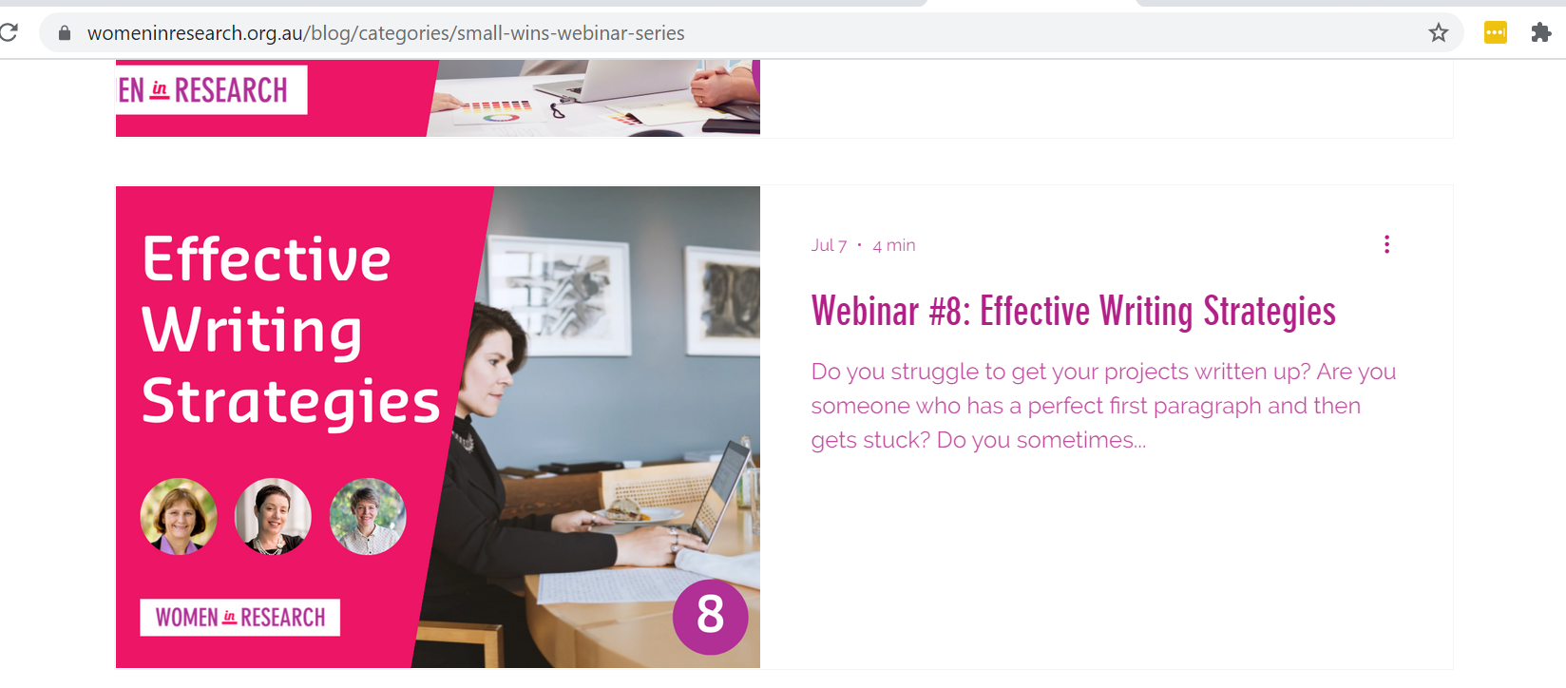
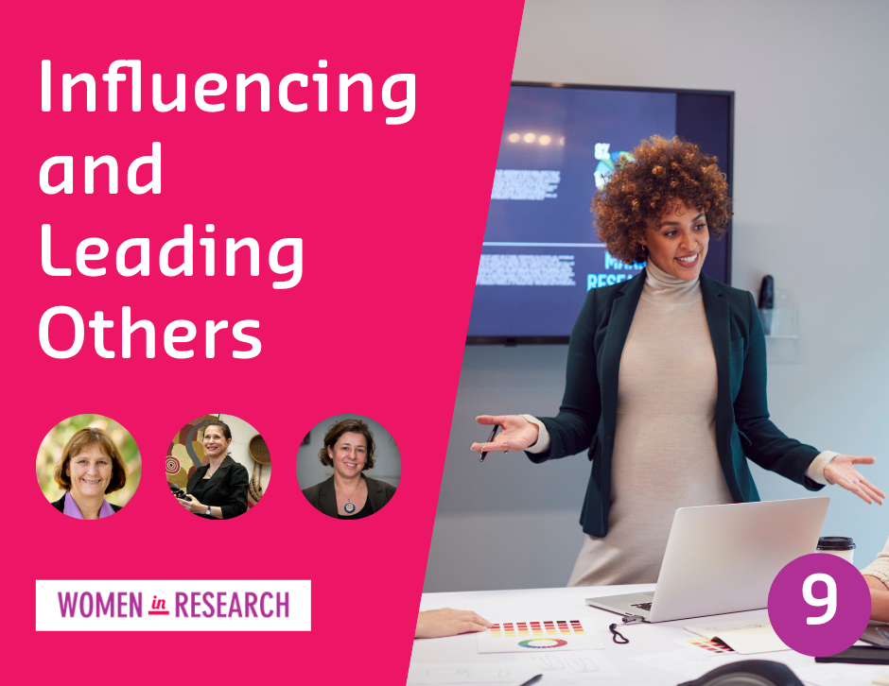
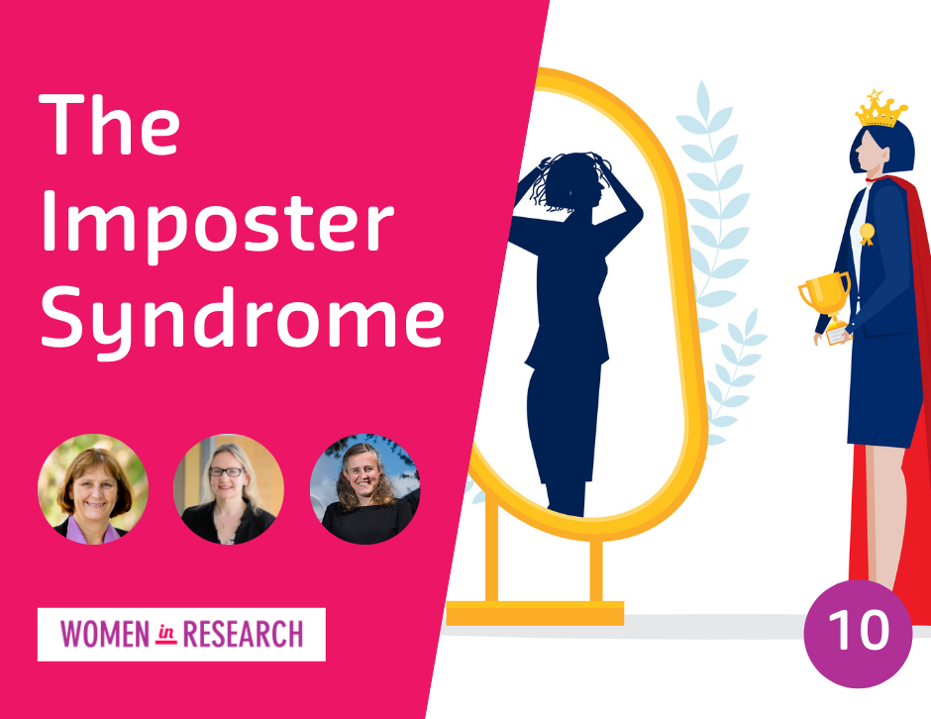

For more resources
See womeninresearch.org.au
Next webinar (Wed 8 December): Networking for everyone (including introverts!)

Slide 27
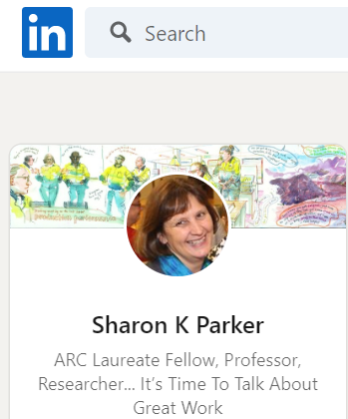

Thank You for Listening!
Questions? Comments? Experiences or Tips You Would Like to Share?

