Slide 1
People, Practices, and Performance: Problems and Prospects
Patrick M. Wright
Thomas C. Vandiver Bicentennial Chair in Business
Director, Center for Executive Succession
Darla Moore School of Business
University of South Carolina

Slide 2
“Our people are our most important asset.” Every company’s mission statement

Slide 3
My guiding assumptions
People are valuable (possess knowledge, skill and ability that can benefit firms as well as intrinsic value and worth)
People have free will (can choose to contribute or not)
How organizations manage them will determine the long term viability of the enterprise
Strategic HRM describes how firms seek to do this in a way that maximizes the value of people by aligning them with the strategic needs of the business

Slide 4
SHRM Defined…
‘…the pattern of planned human resource deployments and activities intended to enable the firm to achieve its goals’ (Wright & McMahan, p. 298).
“deployments” = allocating people to strategic needs
“activities” = HR practices to manage people to have right skills and exhibit right behaviors to effectively execute strategies

Slide 5
SHRM’s Domain
“…the determinants of decisions about HR practices, the composition of the human capital resource pool, the specification of the required human resource behaviors, and the effectiveness of these decisions given various business strategies and/or competitive situations” (Wright & McMahan, 1992; p. 298)

Slide 6
Strategic HRM and Performance
Strategy
What
Employees
Have
Skills,
Abilities,
Competencies
Customer
Outcomes
Satisfaction
Retention
HR Practices
Recruitment
Selection
Training
Development
Performance
Management
Rewards
Communication
What
Employees
Do
Task,
Discretionary,
Counterproductive
Behavior,
Attendance,
Turnover
Financial
Outcomes
Expenses
Revenues
Profits
What
Employees
Feel
Motivation
Commitment
Engagement
Operational
Outcomes
Productivity
Quality
Shrinkage
Accidents

Slide 7
Human Capital, Strategy, and HR: My Thesis
Good research linking human capital, strategy, and HR practices needs multidisciplinary perspectives
HR has focused on how the practices aimed at building, managing, and transforming human capital are related to performance, while largely ignoring the human capital itself.
Strategy has focused on human capital, without much interest in how to build, maintain, and/or transform human capital.

Slide 8
The SHRM Problem
HR Practices Research
Wright &
McMahan
1992
Wright
et al
1994
Lepak & Snell, 1999
Huselid, 1995
Strategic HRM Research

Slide 9
Problem 1:
Strategic HRM research, which should examine the links among practices, people, strategy, and performance, morphed into HR practices and performance research, which has been devoid of both people and strategy

Slide 10
HR Practices and Performance: HR Approach
Customer
Outcomes
Satisfaction
Retention
HR Strategy
Recruitment
Selection
Training
Development
Performance
Management
Rewards
Communication
Financial
Outcomes
Expenses
Revenues
Profits
Operational
Outcomes
Productivity
Quality
Shrinkage
Accidents

Slide 11
Evolution of HR Practice-Performance
Phase 1 – Control/Commitment
Phase 2 – HPWS (Universalistic)
Phase 3 – Mediation (Still universalistic)
Phase 4 – Alternatives (HIWS, HCWS, H?WS)
Phase 5 - Sub-Domains
AMO
Control/Commitment

Slide 12
Problem 2: Measurement of HR Practices
The identification and measurement of HR practices has been neither consistent nor coherent
Measurement scale (%, 1-5, etc.)
Measurement scope (all ee’s, core ee’s, etc.)
Measurement reliability
Which practices?

Slide 13
Problem 3: Replacing Science with Advocacy
Began as Descriptive (Control vs. Commitment)
Walton (1985) Arthur (1992, 1994)
Became Normative
Commitment/Involvement/High Road
Need to drop our Normative Blinders and study the phenomenon as it is, not as we hope it to be
Eg., control vs. commitment or control AND commitment?

Slide 14
A New SHRM Governance Typology
High
Compliance
Low
Disciplined
Hybrid
Unstructured
Bonded
Low High
Commitment

Slide 16
Su, Wright, and Ulrich, In Press

Slide 17
A New SHRM Governance Typology
High
Compliance
Low
Disciplined
4.73
Hybrid*
5.30
*Significantly different from all other groups
Unstructured*
4.22
Bonded
4.55
Low High
Commitment

Slide 18
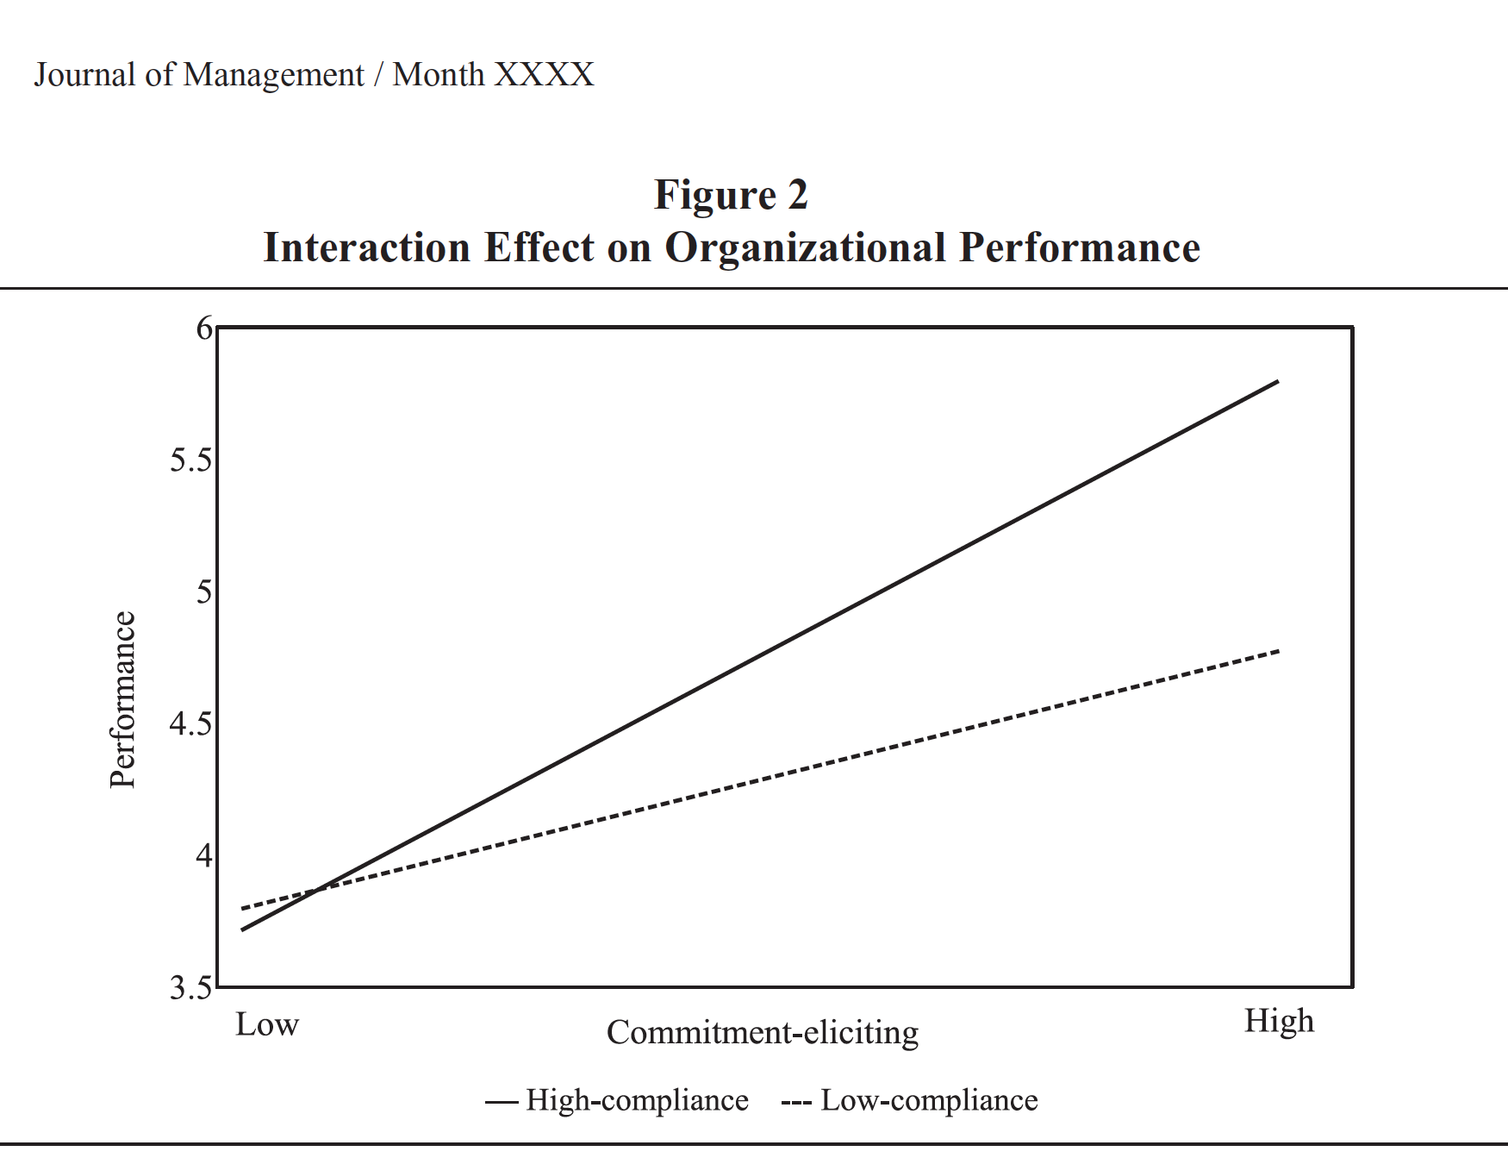

Slide 19
From Practices to People
As you can see, HR practice research continues to thrive.
Much attention has been devoted to affective outcomes of HR practices (e.g., organizational commitment)
However, much of that work still ignores the human capital

Slide 20
Prospect 1:
HR practices research has begun to broaden:
Alternative models of HR systems
HR researchers have begun to rediscover the “human” in “human resources.”
Identifying the link between practices and people

Slide 21
Enter Strategy…
While HR researchers were chasing the HR practice tail, strategy researchers discovered human capital (e.g., Wiklund and Shepherd, 2003; Hitt et al., 2001)
However, they tended to ignore the complexity of the types of human capital (e.g., cognitive and non-cognitive variations in individual differences)

Slide 22
Problem 4:
Strategy research on human capital has ignored how human capital is attracted, motivated, developed, and retained

Slide 23
Human Capital and Performance: Strategy Approach
Customer
Outcomes
Satisfaction
Retention
What
Employees
Have
Skills,
Abilities,
Competencies
Financial
Outcomes
Expenses
Revenues
Profits
Operational
Outcomes
Productivity
Quality
Shrinkage
Accidents

Slide 24
Definitions/Conceptualizations
‘. . . the knowledge, information, ideas, skills, and health of individuals’ (Becker, 2002: 1)
‘Human capital analysis starts with the assumption that individuals decide on their education, training, medical care, and other additions to knowledge and health by weighing the benefits and costs’ (Becker, 1996: 9–10)

Slide 25
So…
While human capital has entered both the strategy and SHRM literatures, those literatures seem to be using the same vocabulary, but different dictionaries…

Slide 26
Problem 5: A Variety of Measurement Approaches
Strategy:
Proxies (Hitt et al., 2001; 2006)
Stars (Tzabbar, Rothaermel, Groysberg, etc.)
HR:
Subjective Measures (Takeuchi et al., 2007, Carmeli and Shaubroeck, 2005; Wright et al., 1995)
Direct Assessments (Ployhart et al. 2006; Harris et al., 2009)

Slide 27
Prospect 2: More Thorough Measurement
My colleague, Rob Ployhart, exemplifies the potential for linking practices, people, and performance

Slide 28
Example 1: Talent Quality Grows Retail Sales
Store Level Talent Quality
1,036 stores
Store Sales Growth
A 1 SD increase in store talent quality increases:
controllable profit $60,000
same-store-sales 6%
sales per employee $10,000
Enhancing talent quality grows store performance
Individual Competencies
125,106 applicants
Ployhart, Weekley, & Ramsey (2009, AMJ)
Notes:
Ployhart, Weekley, & Ramsey (2009, AMJ)
“For every one-unit increase in unit service orientation, there was (on average) a 6 percent increase in same store sales, a $59,705.20 increase in adjusted controllable profit, and a $10,062.51 increase in sales per employee over time.”
“Stores with consistently higher flows of unit service orientation would “outperform” stores with lower flows. As an illustration, stores with consistent flows of higher unit service orientation (1 s.d. above the mean) increased their sales per employee by $4,000.00 more per quarter than stores with lower flows of unit service orientation (1 s.d. below the mean).”

Slide 29
Example 2: Talent Quality Grows Productivity
Ployhart, Van Iddekinge, & MacKenzie (2011, AMJ)
238 fast food restaurants
Better staffing = greater return on training
Talent Quality supply chain = growth
Talent Acquired Through Staffing
.23
Talent Developed Through Training
.88
Change in
Unit Service
Performance Behavior
.54
Growth in
Unit Sales Per Employee
1% improvement in staffing = 2% improvement in sales per employee
Ensuring all hires meet minimum standards reduces costs 18%
Notes:
Ployhart, Van Iddekinge, & MacKenzie (2011, AMJ)
Van Iddekinge et al. (2009, JAP: 840):
“With selection and training as the predictors, the resulting predicted means for CSP were 92.52 and 84.33, respectively. This indicates that units 2 standard deviations above the mean on the two HR variables are likely to have 8% higher service performance ratings than are units 2 standard deviations below the mean on the HR variables. The predicted mean values for retention were 94.15 and 79.00, which is a difference of 15%. Finally, when service performance and retention were added to the HR variables to forecast unit profits, the predicted means were 105.65 and 94.72, respectively. This means that units 2 standard deviations above the mean on the predictors would, on average, demonstrate 11% higher profits (relative to expectations) than would units 2 standard deviations below the mean on the predictors.”

Slide 30
Problem 6: Conceptualizing and Measuring Human Capital
Individual vs. Collective
Specific vs. General
Ownership/Free Will
Empirical Challenges
Measurement Error/Precision
Aggregation

Slide 31
Prospect 3: Reconceptualizing Human Capital
Given this history and these issues, I’d like to offer a broadening reconceptualization of how we might think about the potential for human capital to add value to a firm
This requires examining the construct across multiple levels

Slide 32
Human Capital and Human Capabilities
Human capital refers to the knowledge, skills, abilities, and other characteristics of individuals.
Human capabilities refers to the aggregated KSAO’s of a group of employees, and their capability to combine their skills and behaviors to perform a set of inter-related tasks

Slide 33
Human Capital
Human Capital
Problem:
While a valuable construct, human capital does not fully capture the role that a firm’s people play
What
Employees
Have
Knowledge,
Skills,
Abilities,
Competencies,
And
Other

Slide 34
Human Capability
Broader View
What
Employees
Have
Skills,
Abilities,
Competencies
Problem:
Again, while a valuable construct, it does not fully capture the context within which employees can create value for the firm
What
Employees
Do
Task,
Discretionary,
Counterproductive
Behavior,
Attendance,
Turnover
What
Employees
Feel
Motivation
Commitment
Engagement
*Wright, 2008, Human Resource Strategy: Adapting to the Age of Globalization

Slide 35
Human Capabilities: Linking Strategy and HR
Human Capabilities
Individual Context:
KSAO’s
Recruitment, Selection, Training, Development
Job Design, Task/Workflow Design,
Team Design
Task Context:
Interdependence
Social Context:
Relationships, Communication, Trust
Team Building, Communications, Rewards

Slide 36
Human Capabilities
Individual Context:
KSAO’s
“…the aggregated KSAO’s of a group of employees, and their capability to combine their skills and behaviors to perform a set of inter-related tasks.”
Employee Cognition
Employee Affect
Task Context:
Interdependence
Social Context:
Relationships, Communication, Trust
Employee Behavior
Hat Tip: Ployhart & Moliterno, 2011

Slide 37
Prospect 4: Distinguishing related constructs helps clarify theory
Human capital and human capabilities are both legitimate constructs for exploring in the value creation process (this is not replacing one construct with another)
The distinction is directly related to the measurement strategy
How we measure may tell us better what we are measuring:
Individual vs. collective
Objective/direct/proxy vs. subjective

Slide 38
Prospect 4: (cont’d)
Individual scores combined – human capital
Leads to question of aggregation model
Average
Diversity
Weakest Link
Strongest Link
Supervisor evaluation of workforce – likely human capability (their perception is influenced by task and social components)

Slide 39
Prospect 5: Strategic Human Capital
Strategic Human Capital provides the platform for interdisciplinary examinations of the role of people in competitive advantage
Multiple SHC conferences across the globe (Utah, USC, Bocconi)
Special Issues on Strategic Human Capital (JOM, 2014; AMP, 2015)

Slide 40
Conclusion
Research on Strategic HRM (people, practices, and performance) has grown exponentially over the last 20 years
The Strategic Human Capital movement has drawn some SHRM researchers back to focus on people again, and provided a platform for multidisciplinary investigations with strategy researchers
A strong future will require simultaneously exploring the roles that people, practices, and strategy play in Managing for Peak Performance

