Slide 1
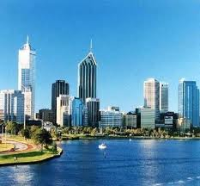


The paradox of leading for stability during volatile times
Rajnandini “Raj” Pillai
California State University San Marcos

Slide 2
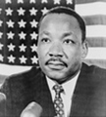

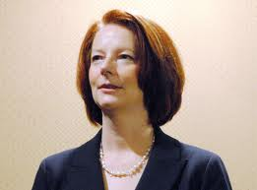
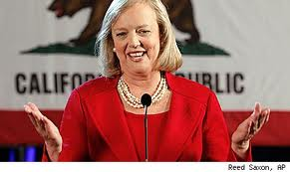


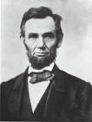
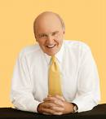
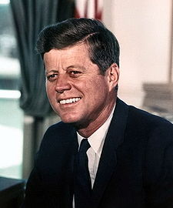

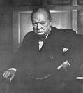
Managing volatility and instability: Is Leadership the answer?
40 greatest leadership speeches!

Slide 3
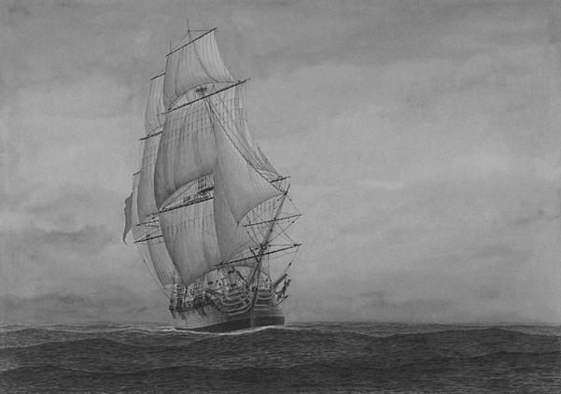
Leadership matters
Companies can’t control the weather, but they can design and build a ship, and equip it with a leadership team, that can navigate the ocean under all weather conditions.
Lowell Bryan, Director, McKinsey’s New York office

Slide 4

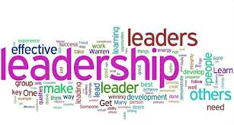
…or does it?
Meindl et al. (1985): The Romance of Leadership; Bligh, Kohles, and Pillai (2012)
Brad Jackson (2012): Why New Zealand should become a leadership testing ground for new models and approaches; Focus on complexity, wicked problems, develop and celebrate leadership, not just leaders!

Slide 5
Volatility and crisis: The new norm
“Rest assured, though, that whether it’s a financial crisis, or a geopolitical crisis, or an energy crisis, or an environmental crisis—turbulence will be the new norm in the years ahead.”
“We are living in a world of
great paradox: insurmountable
challenges and breathtaking
opportunities; At the end of the day,
it is really about leadership.”
Muhtar Kent, CEO Coca Cola

Slide 6
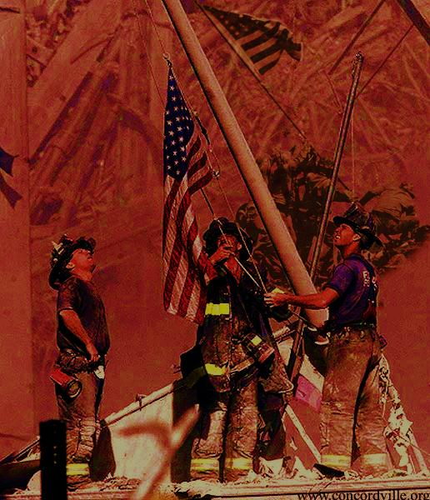
September 11 and the study of leadership
“In the United States at least, leadership changed in some basic way on September 11, 2001….Since 9/11, government officials have been scrutinized for evidence of leadership ability with an intensity usually seen only in wartime.”
                Warren Bennis

Slide 7
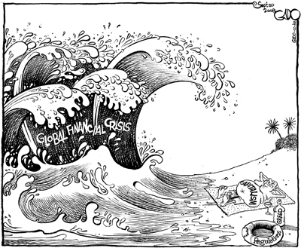
The Global financial Crisis

Slide 8
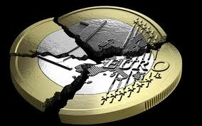
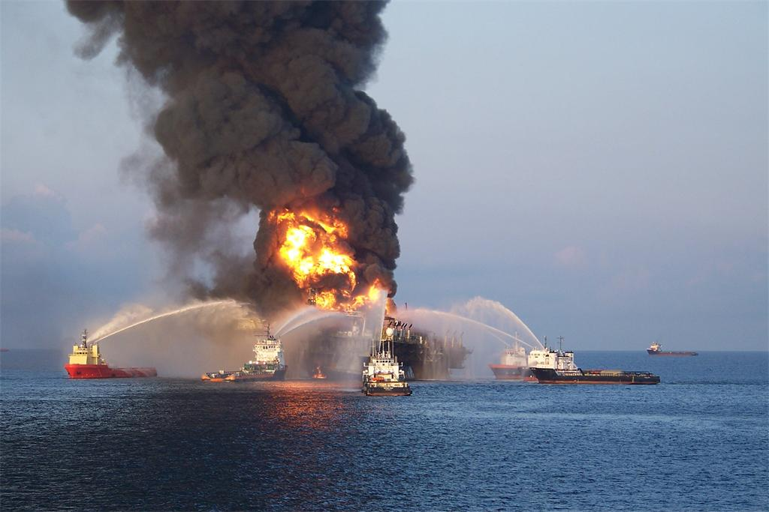

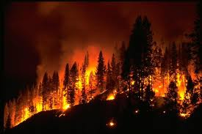
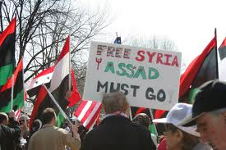
Awash in Crises

Slide 9
McKinsey research: five global forces that will reshape business
The great rebalancing: In the next decade, emerging market countries will grow more than developed ones
The productivity imperative: Need to generate pronounced gains in productivity through dramatic innovations
The global grid: Complex flows of capital, goods, information create both interlinked networks and destabilizing cycles of volatility

Slide 10
McKinsey research: five global forces that will reshape business
Pricing the planet: Tensions of rising demand for resources, constrained supplies, and changing social attitudes towards environmental protection. Emergence of clean tech industries and regulation
The market state: Contradictory demands of driving economic growth and providing safety nets put governments under pressure

Slide 11
Crisis and the emergence of charismatic and transformational leadership
  Experimental Research (Pillai & Meindl, 1998)
  Field Studies (Pillai et. al) : Fire service personnel
  Presidential Leadership Studies (Pillai et al., 1996-2012); The Governateur and the California Recall Study
Crisis
Charisma/TFL
Outcomes

Slide 12
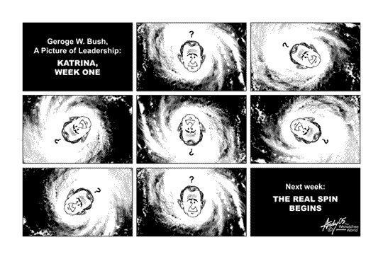
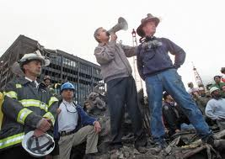
Transformational leadership and crisis
Pearson and Mitroff (1993) : 2 X 2 Matrix
  Orientation of crisis (normal vs. severe)
  Nature of crisis (technical/economic vs. human/social)
  Pillai, Kohles, and Bligh (2007) : Longitudinal study of President Bush managing various crises

Slide 13
Some avenues for future research (Pillai,R. 2013: Transformational Leadership and Crisis)
Exponential growth in the number of research studies and citations on transformational leadership (Antonakis, 2012)
Are some elements of TFL more important to crisis situations in some cultures than in others?
Mixed results with intellectual stimulation; Importance of studying contextual factors and processes
The role of gender; Strategic leadership in managing uncertainty; Complexity leadership
Longitudinal studies; Role of followers; Toxic leaders in volatile situations

Slide 14
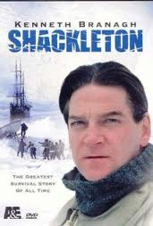
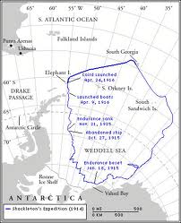
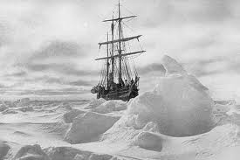
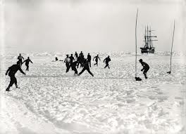
Extraordinary leadership in crisis
Leadership in extreme contexts (Hannah, Uhl-Bien, Avolio, and Cavarretta (2009)
https://www.youtube.com/watch?v=2QrNlbcz7XE

Slide 15
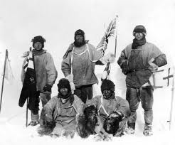
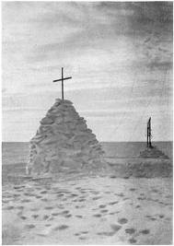
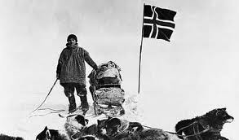
Scott vs. Amundsen and the Race to the South Pole: Lessons for Managing Uncertainty (Jim Collins in Great by Choice, 2011 )
“Amundsen’s philosophy: you prepare with intensity, all the time, so that when conditions turn against you, you control from a deep reservoir of strength”
“Scott left himself unprepared and complained in his journal about his bad luck: “it is more than our share of ill fortune……how great may be the element of luck!”

Slide 16
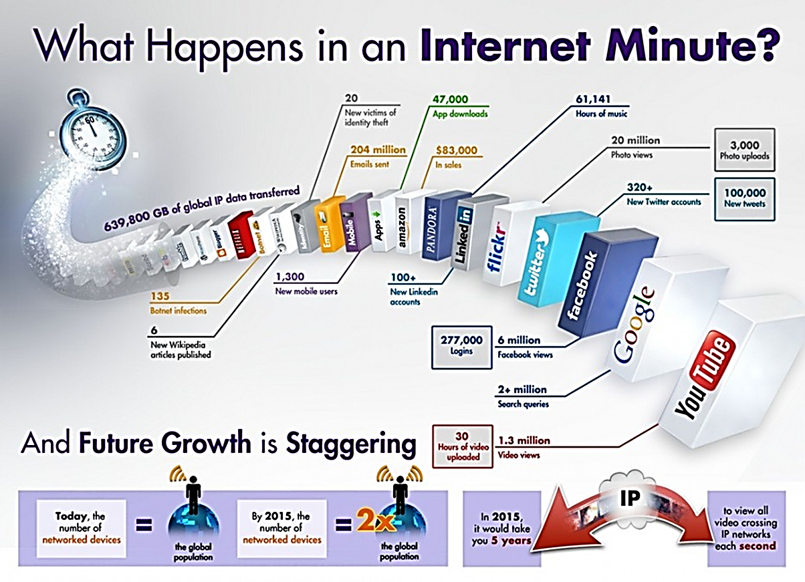

Slide 17
Interviews with CEOs: Managing Volatility
In volatility, the management challenge is to balance risk and rewards in the face of great uncertainty.
Keys to success:
    Crisis management attitude and
    communications
    Cash conservation and cost control
    Continuous and speedy decision-making
    Terry Bruggeman, Ex. Chairman, BioTork LLC

Slide 18
Managing volatility: The CEO perspective
Business is rarely stable
Leaders are prepared!
Leaders have practiced their “Casualty control drills” and “flown in their simulators”
During volatile times, they remain calm, decisive, and, ultimately, comforting and inspiring
Jim Tenuto, CEO Renaissance
Executive Forums (ex Navy)

Slide 19
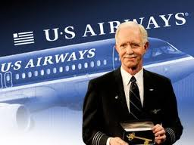
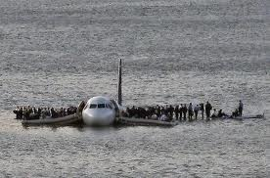

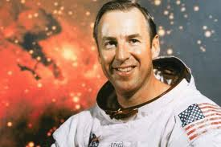
The Miracle on the Hudson (Captain Chesley “Sully” Sullenberger ) and Apollo 13 (Commander Jim Lovell)
“We are going into the Hudson”
“Houston, we have a problem”

Slide 20
Leading in volatile times
Have a plan!
  (Plan A on paper and Plans B & C in your head)
  “A bad plan well executed is better than no plan”
Be optimistic (“Don’t buy into general malaise”)
Be Calm!
  Jerry Rollins, Founder and Chairman, Sage Executive group; serial entrepreneur; sometime Canadian hockey player

Slide 21

Managing volatility: A CEO’s advice
To develop the skill sets necessary for today’s “guide and inspire” environment, leaders need to focus on:
Continual learning and unlearning
Broadening their perspectives
Problem solving
Developing self-awareness
Improving their communication skills
Thinking strategically
Thinking globally
It is a hyper-changing world.
If you don’t feel confused and challenged each and every day as a leader, you clearly don’t have a firm grasp of the new reality!

Slide 22
Provocative idea!
“When women are called to action in times of turbulence, it is often on account of their composure, sense of responsibility and great pragmatism in delicate situations.”
Christine Lagarde, MD, IMF

Slide 23
The crucibles of leadership: Adaptive capacity and creativity
“When we speak of exemplary leadership, we are often talking about exemplary, creative problem solving-the discovery of new solutions to unprecedented problems”
Warren Bennis

Slide 24

Learning to love volatility: Nassim Nicholas Taleb
“By making ourselves too comfortable and eliminating all volatility from our lives, we do to our bodies and souls what Mr. Greenspan did to the US economy: We make them fragile. We must instead learn to gain from disorder”

Slide 25
Leading in the 21st century: McKinsey interview with Dr. Michael Useem
“……if I want to strengthen my leadership for the next five or ten years, meaning not only in myself but in the team of people around me, whom I depend on to get the job done, I want to be better at resilience, at appraising uncertainty. I want to be better at strategic thinking and, by implication, acting strategically. Because the world is now more complicated and more uncertain, I think that on top of always having a great vision there will be a premium on thinking strategically and on being able to come back from setbacks, and maybe above all, on being very good at reading the increasingly ambiguous and uncertain universe we operate in.”
  Michael Useem, Dir. Center for Leadership and Change Management, Wharton School, University of Pennsylvania
http://www.mckinsey.com/features/leading_in_the_21st_century/michael_useem

Slide 26
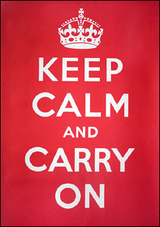
Above all…….

