Slide 1
International Accreditation beyond AACSB
Professor Nigel Healey, Pro-Vice-Chancellor and Head of College of Business, Law and Social Sciences
Nottingham Trent University

Slide 2
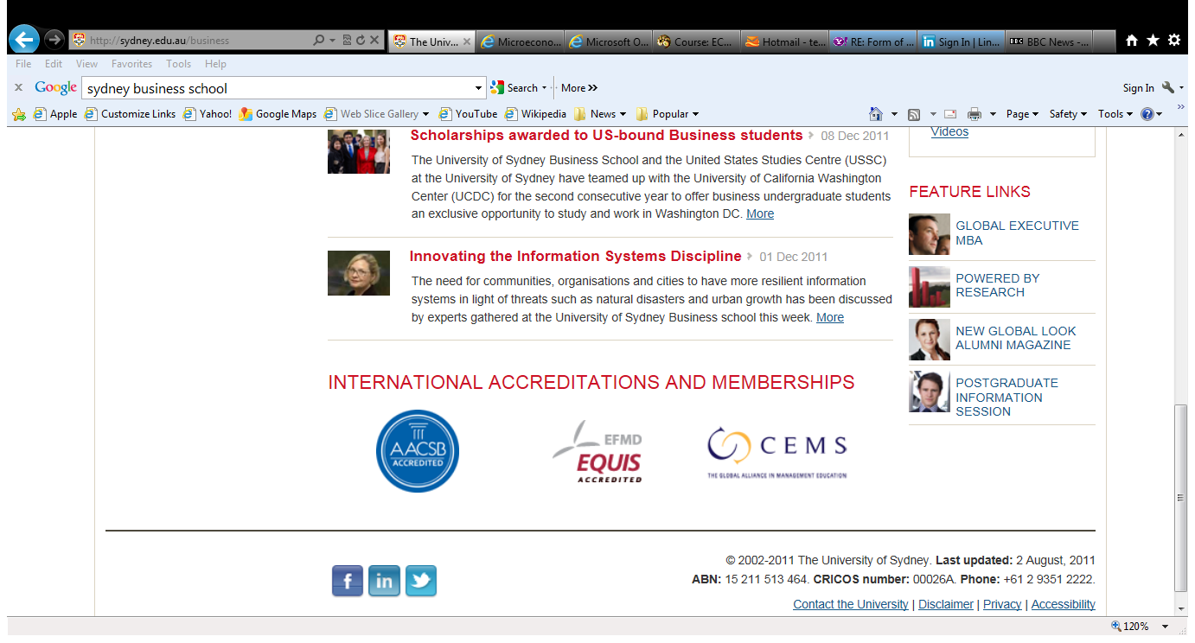

Slide 3
Overview
“accredere” = “give credence to” or “put faith in”
International accreditation:
  AACSB
  EQUIS
  AMBA
Why bother with accreditation?
  The benefits
  The costs
The alternatives to international accreditation
  National and international rankings
Conclusions

Slide 4
International accreditation: the choices
AACSB - The Association to Advance Collegiate Schools of Business (based in Tampa, Florida)
AMBA - The Association of MBAs (based in London)
EQUIS - European Quality Improvement System (based in Brussels)

Slide 5
Scope of accreditation
AACSB accredits management and accounting programmes for the university overall
  only scheme which is overtly mission-based
AMBA accredits the business school's portfolios of MBA/MBM/DBA programmes (wherever offered)
EQUIS's accredits the business school as an entity

Slide 6
Timing
Duration of the accreditation process
  AACSB: 5-6 years
  AMBA: 9-12 months
  EQUIS: 2-3 years
Length of accreditation
  AACSB: 5 years, but light touch reaccreditation after 5 years, fuller reaccreditation after 10 years
  AMBA: full re-accreditation every 3 or 5 years (1-year accreditation is a possible outcome of reaccreditation, by exception)
  EQUIS: full re-accreditation every 3 or 5 years

Slide 7
Complexity
AACSB: 77 pages for Business Accreditation, more quantitative criteria (checklists)
  eg, prescribed faculty ratios
AMBA: 24 pages (9 pages for MBA; 9 pages for MBM; 6 pages for DBA), more qualitative criteria
  eg, no prescribed faculty-to-students ratio
EQUIS: 67 pages, mix of qualitative and quantitative criteria
  eg, prescribed minimum numbers of faculty

Slide 8
Numbers of schools accredited
AACSB, estimates there are now 13,670 business schools world-wide
As of November 2011:
  AACSB accredits 637 institutions in 41 countries
  AMBA accredits 187 schools in 70 countries
  EQUIS accredits 130 schools in 38 countries

Slide 9
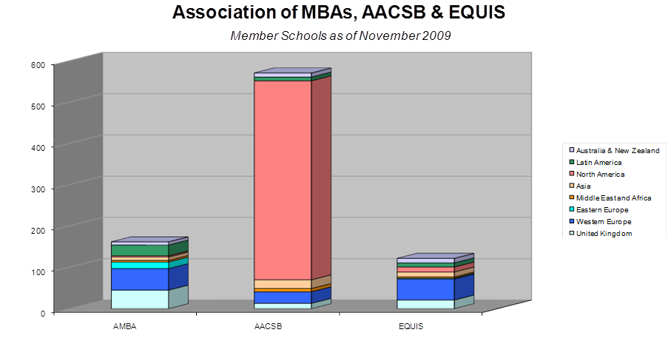

Slide 10
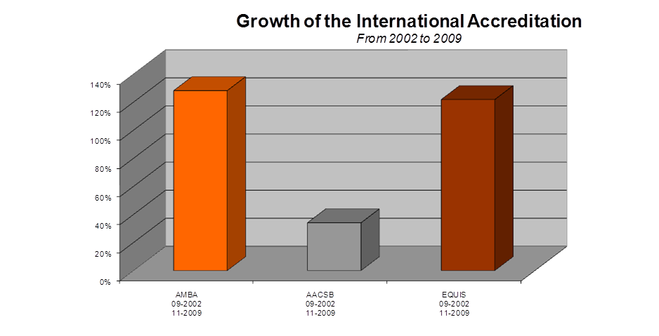

Slide 11
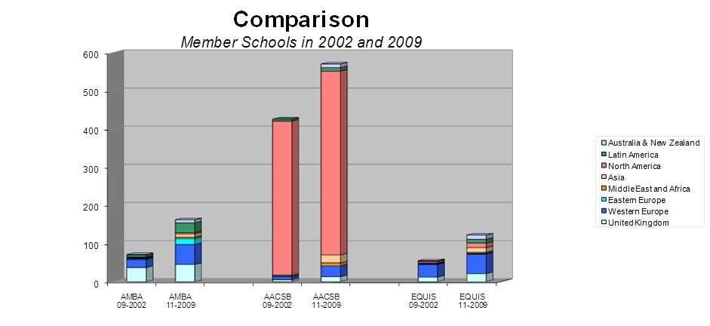

Slide 12
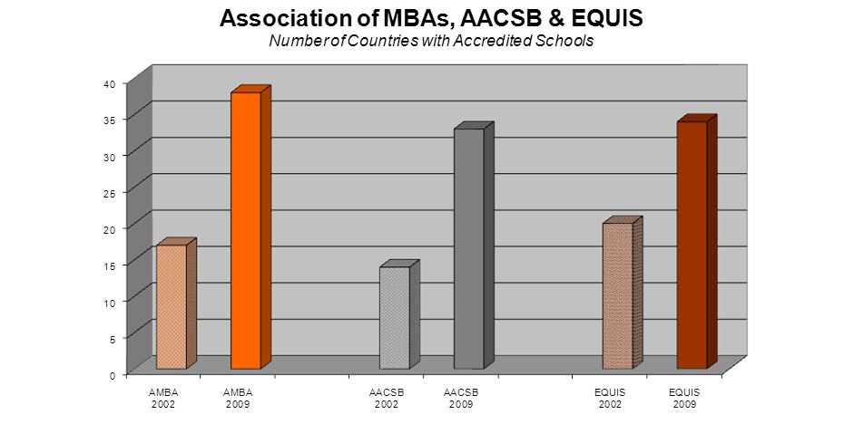

Slide 13

AACSB accredited ANZAM universities
Australian Graduate School of Management
Griffith University
Melbourne Business School
Queensland University of Technology
The University of Adelaide
University of Melbourne
The University of Queensland
The University of Sydney
University of Technology, Sydney
University of Western Australia
Auckland University of Technology
Massey University
The University of Auckland
University of Otago
The University of Waikato
Victoria University of Wellington

Slide 14
AMBA accredited ANZAM schools
Curtin Graduate School of Business
Monash Graduate School of Business
QUT Graduate School of Business
Massey University
Waikato Management School
University of Auckland Business School
University of Canterbury
Victoria University of Wellington, Faculty of Commerce & Administration

Slide 15

EQUIS accredited ANZAM schools
Melbourne Business School (5 years)
Faculty of Business and Economics, Monash University (3 years)
QUT Business School (5 years)
Business School, The University of Western Australia (3 years)
Australian School of Business (5 years)
UQ Business School (5 years)
Division of Business, University of South Australia (3 years)
University of Sydney Business School (5 years)
Business School, The University of Auckland (5 years)
School of Business, University of Otago (3 years)
Waikato Management School (5 years)

Slide 16
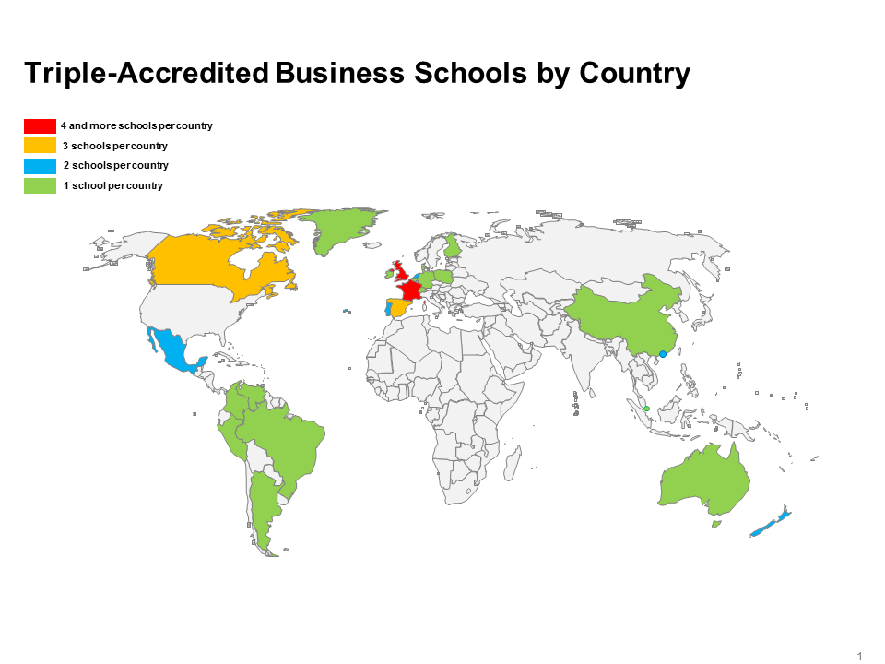
The “Triple Crown”
Queensland University of Technology
University of Auckland
University of Waikato

Slide 17
Why bother with accreditation: the benefits
Provides an independent, objective framework which allows schools to benchmark against international standards and enhance quality in key areas: faculty, learning outcomes for students, research, corporate relations, internationalisation
Signals guarantee of quality to future students and faculty
Provides quality kite mark for schools to differentiate themselves from the rest

Slide 18
Why bother with accreditation: the benefits (2)
Provides quality kite mark for schools to differentiate themselves from the rest…
Tension for accreditation bodies between:
  Raising standards (more members) vs exclusivity (few members)
  Generating revenue (more members) vs retaining brand quality (few members)
AACSB and AMBA weight raising standards ahead of exclusivity
EQUIS give greater weight to exclusivity
  but risks providing lower value-added to schools given national and international league tables

Slide 19
Why bother with accreditation: the costs
Deadweight costs; bureaucracy to gather data, complete forms, costs of accreditation visits
Strategic costs: may require change of mission or unwanted change to strategy
  AACSB’s focus on university: prevents b-schools in universities with other management programmes from applying
  AMBA’s rule that MBA entrants require three years’ work experience: Harvard Business School, Wharton, Stanford GSB, Columbia Business School, Chicago Booth all do not meet this requirement
  EQUIS’s rule that b-school’s must be autonomous: works against b-schools which are fully integrated into universities

Slide 20
The alternatives to international accreditation: national rankings
Australian Business School Rankings
University of Melbourne (MELBOURNE)
University of New South Wales (UNSW)
University of Sydney (SYDNEY)
Australian National University (ANU)
Monash University (MONASH)
University of Queensland (QUEENSLAND)
University of Western Australia (UWA)
Macquarie University (MACQUARIE)
University of Adelaide (ADELAIDE)
University of Technology Sydney (UTS)
Queensland University of Technology (QUT)
Curtin University of Technology (CURTIN)
http://www.australian-universities.com/ratings/business-school-rankings/

Slide 21
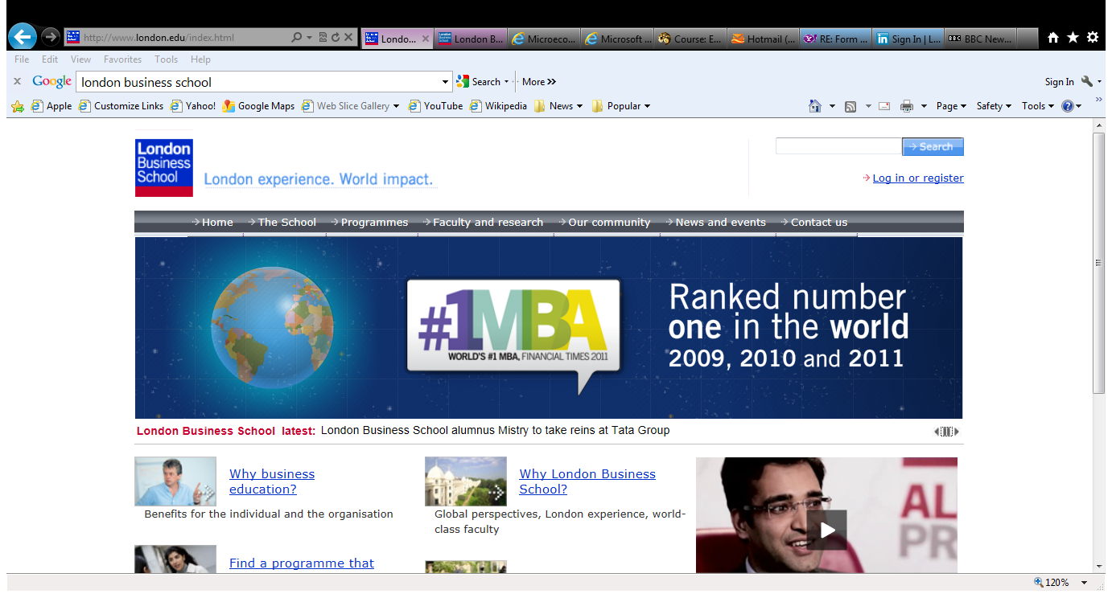
London Business School has ‘Triple Crown’, but…

Slide 22
The alternatives to international accreditation: national rankings (2)
Australian Business School Rankings (MBA)
Melbourne Business School, University of Melbourne
Australian Graduate School of Management
Macquarie Graduate School of Management
Faculty of Business - Bond University
Faculty of Business - Queensland University of Technology
Curtin Business School
University of Tech Sydney - Business Faculty
Griffith University
Mt Eliza Center for Executive Education - Melbourne Business School
Graduate School of Business - RMIT University
Graduate School of Management - University of Western Australia
The University of Queensland
http://top-b-schools.4gmat.com/australia.shtml/

Slide 23
The alternatives to international accreditation: international rankings
Asian Business School Rankings (MBA)
1. Melbourne Business School, The University of Melbourne
2. National University of Singapore Business School
3. University of New South Wales, AGSM MBA Programs
4. Indian Institute of Management Bangalore
5. Indian Institute of Management, Ahmedabad
6. China Europe International Business School (CEIBS)
7. The HKUST Business School
8. Indian School of Business
9. Nanyang Business School, Nanyang Technological University
10. Macquarie Graduate School of Management, Macquarie University
11. Indian Institute of Management Calcutta
12. Monash University Faculty of Business and Economics
http://www.topmba.com/mba-rankings/global-200/2010/region/asia

Slide 24
Limitations of rankings
Accused of being meaningless:
  add up ‘apples’ and ‘oranges’
  ignore mission or (worse) assume all institutions’ missions are the same as the top-ranked institution
Only indirectly promote quality enhancement
  Universities have to work out algorithms and make changes to improve their rankings
  No direct feedback to improve quality
  Focus on rankings may lead to game-playing

Slide 25
Conclusions
Achieving international accreditation ahs become an objective for many Australian b-schools
There are both real and reputational benefits from accreditation, which come at a cost
Rankings are also a fact of life and provide reputational benefits, but they are harder to manage
In a competitive environment, both serve to help b-schools differentiate themselves from the pack

