Slide 1
Dynamic Capabilities and Related Paradigms
David J. Teece
Tusher Center for Intellectual Capital Management
Haas School of Business, University of California, Berkeley
2 December 2015
ANZAM 29th Annual Conference of the Australian & New Zealand Academy of Management
“Managing for Peak Performance”

Slide 2
Part 1: Background Factors

Slide 3
Top and Bottom Profit Margin Percentiles
Source: Compustat
Notes:
Profit margin is defined as EBIT divided by revenue
The sample was restricted to firms with $100 million in revenues in at least one of the years between 1965 and 2014
Revenue field was considered missing whenever it was zero or negative
Industries were defined using manual grouping by the 2-digit SIC code. Quartiles were calculated across all industries
Only years with the minimum number of 20 companies were considered
Industries included: Multiple

Slide 4
Source: Compustat
Notes:
Fraction of 3 largest firms in each industry (in terms of revenue) which are also in the top (75th) probability percentile across all industries
The sample was restricted to firms with $100 million in revenues in at least one of the years between 1965 and 2014
Profit margin is defined as EBIT divided by revenue. Revenue field was considered missing whenever it was zero or negative
Industries were defined using manual grouping by the 2-digit SIC code. Quartiles were calculated across all industries
Only years with the minimum number of 20 companies were considered
Industries included: multiple
R-squared= 22.73%

Slide 5
Conventional versus “Next Generation” Strategic Management
Conventional Concept 20th Century: | Next-Generation Concept 21st Century:
Static Competition | Dynamic Competition
Risk | Deep Uncertainty
The West and the Rest | A Semi-Globalized World
Industry-level Analysis | Ecosystem-level Analysis
Homogeneous Firms | Heterogeneous Firms
Single-Invention Innovation Model | Multi-Invention Innovation Model
Vertical Integration/In house R&D | Modularization
Traditional Tools | Requires Newer Approaches
D.J. Teece, Next-Generation Competition: New Concepts for Understanding how Innovation Shapes Competition and Policy in the Digital Economy, Journal of Law, Economics, & Policy, (fall 2012)

Slide 6
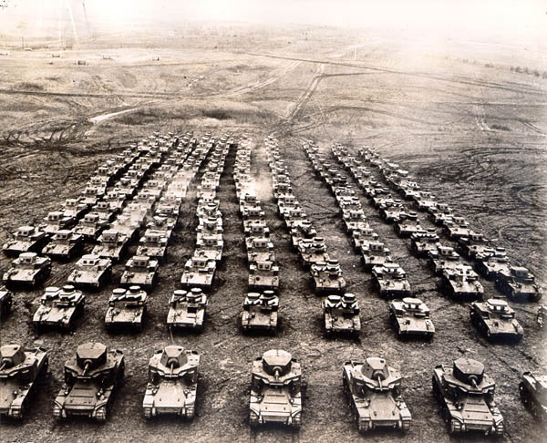
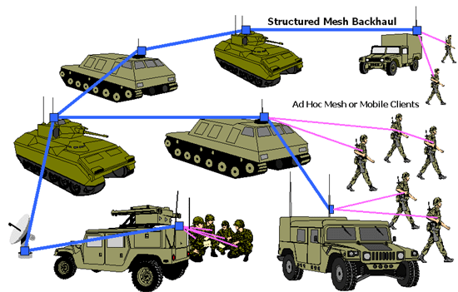
FROM ASSET ACCUMULATION TO DYNAMIC CAPABILITIES: A PARADIGM SHIFT
Old approach
New approach
“Balance sheet” view of assets
Little emphasis on flexibility as the key to success
Resources, not capabilities, tend to matter
Recognition of “soft” assets
Heavy emphasis on “orchestrating assets” for deployment and redeployment

Slide 7
Part 2: Dynamic Capabilities Framework

Slide 8
The fundamental question in Strategic Management:
How do firms build long-run Competitive Advantage?
Limited ability of a firm to generate “supernormal” profits over the long run
Competitive advantage is often fleeting
Few firms change and thrive over the long haul: GE, IBM, 3M, Apple…
My thesis: With deep uncertainty, strong asset orchestration, internally and externally, coupled with good strategy and the astute assembly of resources undergirds Dynamic Capabilities which enables supernormal profits
Definition of Dynamic Capabilities: “The ability of an organization and its management to integrate, build, and reconfigure internal and external competences to address rapidly changing environments” (Teece et al., 1997: 516)
Copyright Teece 2014

Slide 9
The evolution of strategic management & “research based” thinking
The Dynamic Capability model is only the third substantive framework for maintaining competitive advantage to emerge in the last 35 years
Deep Uncertainty
Dynamic Capabilities
-Markets are dynamic and competition is often disruptive
-Asset orchestration & strategy drive advantage
-Reshaping ecosystems & biz models is critical
RBV
VRIN assets drive value creation
barriers to competition determine longevity
all 4 VRIN
traits necessary to sustain advantage
Risk
5 Forces
industry attractiveness is the central focus
external forces
dominate
fate = static, purely competitive markets (low profit)
1980s
1990s
2000+

Slide 10
Strategic Management requires differentiation between risk and uncertainty
Risk
prA
prB
Pr(DIA)
Pr(CIA)
Pr(FIB)
Pr(CIB)
C
D
E
F
Alternative futures with known probabilities & known conditional probabilities

Slide 11
Strategic Management requires differentiation between risk and uncertainty
Uncertainty
F?
F1
F2
F?
F3
F?
F4
F?
F?
F?
F?
F?
F?
F?
F?
F?
Don’t know most futures or their probabilities (unknown unknowns)
F 1-4 are possible futures
F? are undefined futures

Slide 12
“Ordinary” (or normal) Capabilities: resources used efficiently but not necessarily deployed right
Routines / standard operating procedures are key to ordinary capabilities
Ordinary capabilities reflect technical efficiency
“Best practices” logic connected to strong ordinary capabilities
Diffusion by rivals is enabled by
More information in the public domain
Better business school training
Management consultants
Admittedly, not everyone gets the simple stuff right

Slide 13
Dynamic capabilities can be thought of as falling in three categories:
Sensing
Identification of
opportunities &
threats at home
and abroad
Seizing
Mobilization of
resources to
deliver value and
shape markets
Transforming
Continuous renewal
and periodic major
strategic shifts

Slide 14
Capabilities and Tools Required for Stable & for Uncertain Environments are Very Different
Newer/Tools/Approaches
Influence Diagrams
Scenario Planning
Peripheral vision
Total Risk Management
Systems Thinking
Idealized Design
Leigitimation Theory
Honing Institution
Complexity Theory
Domain of Ordinary Capabilities
Certainty
Risk
Uncertainty
Ambiguity
Chaos/Ignorance
Known
Unknown
Unknowable
Traditional Tools/Approaches
Cost Benefit Analysis
Net Present Value
Linear Programming
Point Forecasting
Optimization Theory
Utility Theory
Decision Trees
Bayesian Updating
Monte Carlo Simulation
Portfolio Theory
Stochastic Modeling
Insurance & hedging
Domain of Dynamic Capabilities

Slide 15
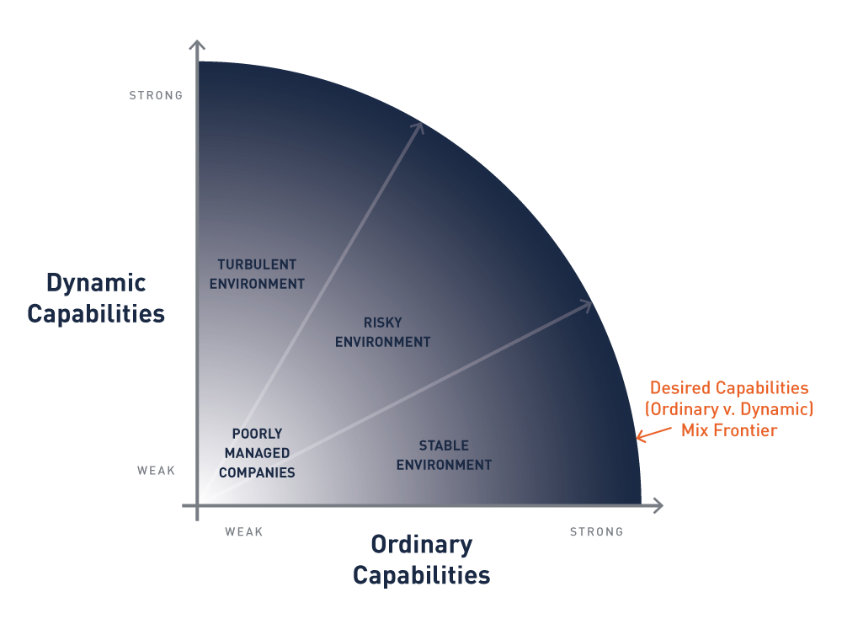
Deep uncertainty requires dynamic capabilities

Slide 16
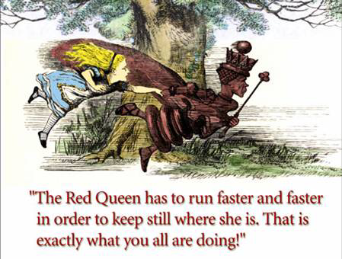
The Problem:
Lewis Carroll, “Through the Looking Glass”

Slide 17
Red Queens:
Some firms learn and sometimes advance, but others copy/imitate/emulate and take the advantage away.
Learning does not lead to a competitive advantage… imitation is the reason advantage (based on ordinary capabilities) is repeatedly lost

Slide 18
FROM ORDINARY TO DYNAMIC CAPABILITIES IN AUTOS
When ordinary capabilities are widely diffused leading to “Red Queen” effects in autos:
The operations portion of the automobile business has been thoroughly optimized over many decades, doesn’t vary much from one automobile company to another, and can be managed with a focus on repetitive process. It requires little in the way of creativity, vision or imagination. Almost all car companies do this very well, and there is little or no competitive advantage to be gained by “trying even harder” in procurement, manufacturing or wholesale.
Competitive advantage requires innovation and dynamic capabilities:
Where the real work of making a car company successful suddenly turns complex, and where the winners are separated from the losers, is in the long-cycle product development process, where short-term day-to-day metrics and the tabulation of results are meaningless.
Bob Lutz, former vice chairman at General Motors
Wall Street Journal, June 11, 2011

Slide 19
FROM ORDINARY TO DYNAMIC CAPABILITIES IN THE US ARMY
“ We had a culture in our forces, of excellence. It was how good can I be at my task? How good can I be at flying an airplane, dropping bombs, locating an enemy target? But that’s not as important as how well those pieces mesh together.”
“The real art is [in] cooperating with civilian agencies, it’s cooperating with conventional forces, it’s tying the pieces together. That’s the art of war, and that’s the hard part.”
-Quotes from General Stanley McChrystal, Foreign Affairs (March/April 2013)

Slide 20
Dynamic Capabilities: Implementation
SEIZE
SENSE
Revise policies/actions
Restructure assets
Reshape business models
Review decision making
SHIFT
Co-specialized assets
Governance/structure
Beyond best practices
Vision/Mission alignment
Scanning processes
(continuous)
Sense-making (inc’g analysis)
Ecosystem
(re)shaping
R&D/innovation (invest/monitoring)

Slide 21
Sensing
The ability to foresee future opportunities and threats… what Jack Welsh (CEO of GE) once referred to as the ability to “see around the corners”

Slide 22
Sensing Cont.
Sometimes sensing is enabled by internal R&D activities (“search activities”) and internal scenario planning and other tools to probe the future
Internal R&D can be complemented (but not displaced) by crowd-sourcing ideas, or by tapping into ideas of customers (Von Hippel), supplies and/or other partners
The challenge is to develop valid hypotheses about what is going on in the market

Slide 23
Good Sensing Requires “Abductive” Reasoning
Explanations are developed for surprising or anomalous behavior/phenomenon
Induction & deduction depend on the past
Abductive reasoning moves ahead through “logical leaps of the mind” and uses all available data in a search for patterns
Once an abductive hypothesis is established, data is searched to test the hypothesis, which in turn spurs original thinking
Not used to determine if something is true or false, but to indicate a new path to “deep truth” about a phenomenon or a situation

Slide 24
Logical Implications of Abductive Reasoning
If an investment option has a deductive logic, then the options can only ever reflect thinking that started with a proven template
If an option has an inductive logic, then “new” options simply follow an established template
Neither inductive or deductive logic allow one to find fundamentally new knowledge. Abduction digs deeper and helps create new knowledge
Management must suppress a tendency to apply known rules; abductive reasoning is the handmaiden of sensing

Slide 25
Asset Orchestration is Central to Dynamic Capabilities
“Apple still has strong growth opportunities because of its ability to work simultaneously on hardware, software and services… Apple has the ability to innovate in all three of these spheres and create magic… This isn’t something you can just write a check for. This is something you build over decades.”
-Tim Cook, Apple CEO (Taipei Times, February 2013)

Slide 26
Entrepreneurial Leadership Matters

Slide 27
Dynamic Vs. Ordinary US Dynamic Capabilities
Ordinary
Capabilities
Dynamic
Capabilities
Purpose
Purpose
Technical efficiency in basic business functions
Operational, administrative, and governance
Relatively easy; imitable
Technical efficiency in basic business functions
Operational, administrative, and governance
Relatively easy; imitable
Strategic “fit” over the long run (evolutionary fitness)
Sensing, seizing, shaping and transforming
Difficult ; inimitable
Tripartite schemes
Imitability
Doing things “right”
Doing the “right” things

Slide 28
Sensing, Seizing & Transforming Are The Practical Pillars Of Dynamic Capabilities
Firm Performance
Opportunity Recognition & Creation
Strategic Investment & Business Model Design
Asset Alignment & Overcoming Change Resistance
Potential Strategic Impacts
Dynamic Managerial Capabilities
Transforming
Sensing
Co-creating and Seizing
Sample Managerial Cognitive Capabilities
Perception and Attention
Problem Solving and Reasoning
Communication and Social Cognition
Source: Helfat & Peteraf (2015, p.837)

Slide 29
Strategy Must Also Married to Capabilities
“A good strategy is a ‘specific’ and ‘coherent’ response to—and approach for overcoming—the obstacles to progress.”
“A bad strategy is a list of blue sky goals or a fluff-and-buzzword infected ‘vision’ everybody is supposed to share.”
- Strategy Kernel (Rumelt, 2009)
Diagnosis
Guiding policy
Coherent action

Slide 30
The Battle of Jutland
The British Navy at the
Battle of Jutland, 1916
“There seems to be something wrong with our bloody ships today.”
“The real deficiency, however, was the loss of [Vice Admiral Horatio Lord] Nelson’s touch. It was not the bloody ships that were principally at fault. It was the inadequate doctrine of command and control.”
Admiral John Jellicoe
Frank Hoffman, “What we can learn from Jackie Fisher,” Proceedings of the Naval Institute, April 2004, p. 70.

Slide 31
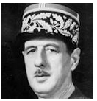
“You have to be fast on your feet and adaptive or else a strategy is useless.”
Charles de Gaulle, French general and statesman

Slide 32
Strategy–Dynamic Capabilities Nexus
Strategy Kernal
Diagnosis | Guiding Policy | Coherent Action
Sensing | Seizing/Transformation | Seizing/Transformation
Entrepreneurial; Managerial | Administrative/Managerial | Leadership; Managerial
Related Dynamic Capabilities Clusters
Primary Managerial Style Required

Slide 33
Concluding Proposition:
Ordinary capabilities are not usually enough to yield sustained competitive advantage. Dynamic capabilities coupled with a validated strategy enable an organization to change in a manner that supports evolutionary fitness and sustainable advantage.

Slide 34
Part 3: Related Paradigms

Slide 35
The Dynamic Capabilities Framework is Integrative
A multidisciplinary framework that draws on numerous concepts, including:
Concepts and Tools | Fields
Business model design | Knowledge management
Decision analysis | Leadership & change management
Economic analysis | Marketing
Entrepreneurship | Operations management
Finance | Organizational Behavior
 | Complexity Theory

Slide 36
There are also numerous paradigms that capture elements of Dynamic Capabilities
Paradigms
Primary Authors
Disruption
Lean Startup
Open Innovation
Remix
SECI
Obliquity
OODA Loops
Profiting from Innovation
Clay Christensen
Eric Ries
Henry Chesbrough
Gomes-Casseres
Jiro Nonaka
John Kay
Col. John Boyd
David Teece

Slide 37
Disruption- Clay Christensen
A process whereby a smaller company with few resources successfully challenges an incumbent
Incumbents are vulnerable when they focus on improving their products and services for their most demanding customers (causes them to be “blindsided” by new entrants)
New entrants get traction at the lower end, then more upmarket
When mainstream customers start adopting the entrants offerings in volumes, disruption has occurred
C. Christensen, “The Innovator's Dilemma: The Revolutionary Book That Will Change the Way You Do Business”, HarperBusiness; Reprint edition (October 4, 2011)

Slide 38
Disruptive innovations originate in (a) low end or (b) new market foothold
Unless a new entrants is on a disruptive trajectory, it can be ignored
Under Christensen’s definitions, Netflix is a disruptor; Neither Uber nor Tesla are
Implications
Because disruption can take time incumbents frequently overlook competition
Disruptions often build different business models which may lower their competitive profile
Learning ( by the new entrant) and strategic blind spots (framing errors) by the incumbent are implicit in the paradigm

Slide 39
Helps embellish dynamic capabilities:
Emphasis incumbents inability to sense
Implicit assumes decision making (framing) errors by incumbents
Highlights the competition aspect of business model innovation
Implicit market segmentation vulnerabilities

Slide 40
Lean Startup – Eric Ries
An approach to entrepreneurship and new enterprise development
Emphasis on learning and pivots
Deemphasizes planning
Eric Ries
E.Ries, “The Lean Startup”, Crown Business; First Edition edition (September 13, 2011)
Steve Blank

Slide 41
Learning (Under Deep Uncertainty) is Key
“ I’ve come to believe that learning is the essential unit of progress for startups. The effort that is not absolutely necessary for learning what customers want can be eliminated. I call this validated learning because it is always demonstrated by positive improvements in the startup’s core metrics”
Eric Ries, The Lean Startup, 2011, p.49

Slide 42
“Tuning” and “Pivots” … two lean startup concepts that mesh with dynamic capabilities
Ordinary capabilities involve “tuning the engine”… a process of optimization
Circumstances often require a change in strategy or in business models. This is called “pivot” and requires agility…which is relatively easy for a startup

Slide 43
What Entrepreneurial Managers Do and Don’t
They rarely become infatuated with setting MR=MC…though every so often technical and financial support personnel may perform such calculations.
Rather, in real life… a lot is happening simultaneously…acquiring new customers and serving existing ones, raising capital, building capabilities, trying to improve the product, improving operations, deciding if and when to pivot
Eric Ries, The Lean Startup, 2011, p.24

Slide 44
Issues with Lean Startup
Focus is on startup…only one aspect of what’s required for established companies to have dynamic capabilities
Not explicitly grounded in theoretical framework…but deep uncertainty is implicit
Mechanisms for sensing and seizing not well specified

Slide 45
Reeves (BCG): Strategy Needs Strategy
Offer “strategy palette” to combine different approaches
Defines business environment according to predictability, malleability and harshness
Strategies should be selected according to environment e.g. “classical” when there is low unpredictability and low malleability; renewal when there is harshness (Classical approaches include BCG growth matrix and Porter’s 5 forces)
Adaptive strategies are suitable when prediction is hard and advantage is short lived
Visionary strategies work when managers can reliably create (shape) or recreate (reshape) an environment all by themselves
M, Reeves, “Your Strategy Needs a Strategy: How to Choose and Execute the Right Approach”, Harvard Business Review Press (May 19, 2015)

Slide 46
Different approaches to strategy required across the business life cycle
Adaptive
Shaping
Unpredictability
Classical
Visionary
Malleability
M, Reeves, “Your Strategy Needs a Strategy: How to Choose and Execute the Right Approach”, Harvard Business Review Press (May 19, 2015)

Slide 47
Elements in Common with Dynamic Capabilities
The classical approach to strategy is not relevant unless there is no imminent risk of disruption
The right strategy depends on the circumstances facing the firm
Classical disciplines of focus, efficiency, planning, and accountability work where the business is highly “planable”
Growth per se is not a strategy…it needs to be focused not indiscriminate
Firms need to understand where and how profit is generated…
Firms can (sometimes) win, even if scale disadvantaged, by building and displaying superior capabilities that are hard to replicate
Doing things right can be a comforting substitute for insight generation

Slide 48
Elements in Common with Dynamic Capabilities, Con’t.
Ambidexterity is valuable
With high uncertainty, firms should engage other stakeholders to create a shared vision and orchestrate new combinations

Slide 49
What’s Missing?
Not a coherent framework
Ideas and concepts jumbled…unclear implications
Not tied to fundamental concepts, so hard to understand, elaborate and improve

Slide 50
Open Innovation
“The use of purposive inflows and outflows of knowledge to accelerate internal innovation, and expand the markets for external use of innovation, respectively.”
Henry Chesbrough et al,
Open Innovation: Researching a New Paradigm, Oxford University Press, 2006

Slide 51
Features of Open Innovation
Recognizes that not all ideas/new products can be developed internally.
Relentlessly focused on how to augment internal efforts through accessing external ideas and resources and combining them with critical ideas and resources
Lineage
Companies have always relied (to some degree) on external sourcing of ideas and innovations
However, during the heyday of (i) large corporate R&D labs (1920’s-80’s) and (ii) US technological dominance (1940-90) habits of thinking because quite parochial
Many companies remain caught in the “not invented here” trap

Slide 52
Some elements of open innovation have been around for decades; but, are these elements are new?
Knowledge Dispersion: Greater geographic and organizational dispersion in the sources of new knowledge
Speed: Need to achieve “integration” and new product launch rapidly because of stronger (global) competition
Intellectual property: Stronger IP right expand choices with respect to internal development or licensing
Standards: Publication/acceptance of standards facilitates crowd sourcing
STRONGER GLOBAL COMPETITION HAS ENHANCED THE IMPORTANCE OF OPEN INNOVATION

Slide 53
Open Innovation Enhances Dynamic Capabilities
The open innovation framework can enhance dynamic capabilities (with respect to all three classes of micro-foundations) through explicit recognition that sensing and seizing can be extended to external stakeholders and also to members of crowds

Slide 54
Remix
Ben Gomes-Casseres
Remix Propositions:
Historically (vertical) integration was the norm
Business combinations are now vital
Competition today is a battle of groups of firms against other groups of firms
Combinations seek to create value by combining or repurposing resources
Business combinations help firms recombine resources to create new capabilities
Gomes-Casseres, Benjamin. “Your Strategy Needs a Strategy: How to Choose and Execute the Right Approach”, Harvard Business Review Press (June 9, 2015)

Slide 55
Remix Strategy can Enhance Dynamic Capabilities
Remix brings into focus the importance of:
Asset Orchestration
Ecosystems
Importance of external cooperation

Slide 56
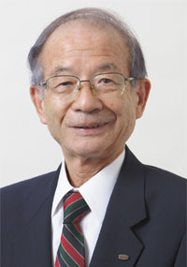
Knowledge Creation: (SECI) Paradigm
The organization creates knowledge through action and interaction
The organization “interacts with its environment, and reshapes the environment and even itself through the process of knowledge creation” (p6)
“The most important aspect… is the dynamic capability to create new knowledge and of existing firm-specific capabilities.” (p6)

Slide 57
SECI Processes
Socialization: Process of tacit knowledge is acquired through shared experiences
Externalization: Process by which tacit knowledge becomes explicit
Combination: Process of converting explicit knowledge into something more complex and systematic
Internalization: Process of embodying explicit knowledge into tacit
F2F (“Ba”) Leads to shared experiences which undergird Nonaka’s knowledge spiral
“The knowledge creating process involves dynamic interactions between organizational members… and the environment”

Slide 58
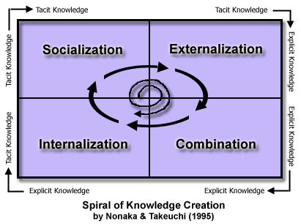
Further research: open innovation & Knowledge co-creation
Based on abduction type logic, SECI requires additional effort to demonstrate how knowledge creation can be married to open innovation and dynamic capabilities

Slide 59
Enhances Dynamic Capabilities
Emphasis on knowledge creation
Implicitly employs abduction reasoning
Helps embellish sensing and seizing

Slide 60
Obliquity
The achievement of wealth, like the attainment of happiness, is an oblique process
Visionary companies tend to make more money than pure profit driven companies
Direct approaches require us to know the method of solution before we start
The world is too complex for directness to work
Directness only works when the world is stable; deep uncertainty requires obliquity
J. Kay, Obliquity: Why Our Goals Are Best Achieved Indirectly, Penguin Books; Reprint edition (March 27, 2012)

Slide 61
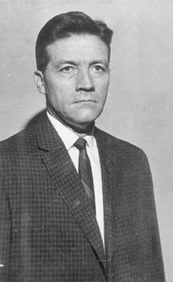
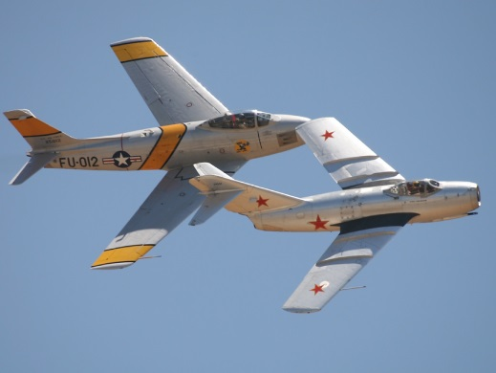
A Generalized Model of Learning & Intelligent Decision-Making
Orient
Decide
Act
Observe
Col. John Boyd
Observe: Taking note of features of the environment (e.g. detecting enemy aircraft)
Orient: Pointing ones aircraft towards the adversary
Decide: Decide what to do next
Act: Implementing what has been decided
(firing the missile)
Boyd’s Approach Favors Agility Over Raw Power,
Dynamic Capabilities Advances a Related and More Central Learning & Decision Making Process

Slide 62
Profiting from Innovative (PFI)
Provides algorithms for “seizing” and predicts the division of profits
Core valuable are appropriability regime
Ownership of complementary assets
Timing
D. Teece, "Profiting from Technological Innovation," Research Policy 15:6 (December 1986), 285–305.

Slide 63
Business Model Implications:
Yes
No
Start Here
Innovation requires access to complementary assets for commercial success
Commercialize Immediately
Complementary assets specialized
Appropriability regime weak
Specialized asset critical
Cash position OK
Imitators/Competitors better positioned
Contract for Access
Contract for access
Contract for access
Contract for access
Contract for access
Yes
No
Yes
No
No
Yes
No
Yes
Integrate
No
Yes

Slide 64
PFI Enhances Dynamic Capabilities
Early insights into business model design
Relates business model choice to the nature (imitability) of innovation and the ownership of bottleneck (complementary)
Static because it consumes an innovation that is communally viable; awards asking where innovation comes from

Slide 65
Paradigm | Primary Authors | Deep Uncertainty | Strategy Present | Business Models | Sensing Critical | Seizing Critical | Transformation | Internal/External Focus | Integrates Other | Assumes Bonded Rationality | Frequent Metaphors/Used
SWOT |  | No | No | No | No | No | No | I/E | No | Yes | ?
Resource based | Penrose | No | No | No | No | No | No | I | Yes | No | Fungible Resources
Ambidexterity | O’Reilly & Tushman | ? | No | No | No | No | No | I | Yes | Yes | Ambidexterity
Disruption | Schumpeter | ? | Yes | Yes | Yes | Yes | Yes | E | No | Yes
Open Innovation | R. Nelson | ? | Yes | No | Yes | No | No | E | No | Yes | Wisdom of Crowds
Obliquity | Kay | ? | No | No | No | No | No | 0 | No | Yes | ?
Lean Startup | Toyota, Blank, Wagner | Yes | Yes | Yes | Yes | Yes | Yes | E | No | Yes | Pivot
Remix | Schumpeter | Yes | Yes | Yes | Yes | Yes | No | E | No | Yes | Constellations, Remix
SECI | Polanyi | No | No | No | No | No | No | I | No | Yes | Tacit Knowledge
Scenario Planning | Wack | Yes | No | No | Yes | No | No | I | No | Yes
Strategy Needs Strategy | Reeves et al | Yes | Yes | ? | ? | Yes | No | No | Partial | Yes
Dynamic Capabilities (Complexity Theory) | Schumpeter, Knight | Yes | Yes | Yes | Yes | Yes | Yes | Yes | Yes | Yes | Mixed Martial Arts

Slide 66
Modified SST
(Sensing, Creating, Seizing, Transforming (SCST)
Scenario Planning & SWOT
Sensing
Co-Creating
Seizing
Transforming
Ambidexterity
Open Innovation
Dynamic Capabilities
Disruption
Lean Startup
Obliquity
Remix

